Slide 1
Our learning through play activities

Slide 2
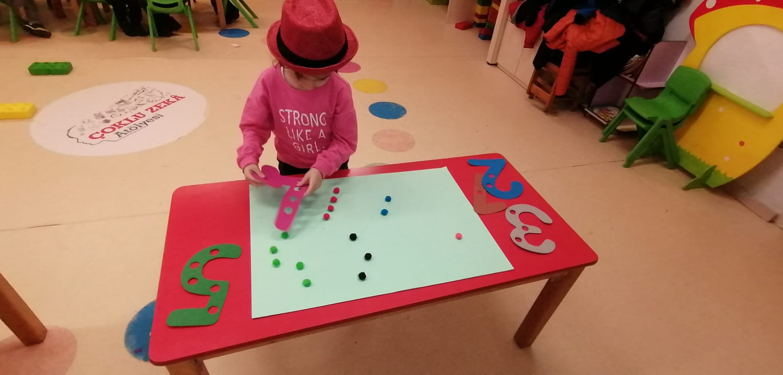
Parkour game

Slide 3
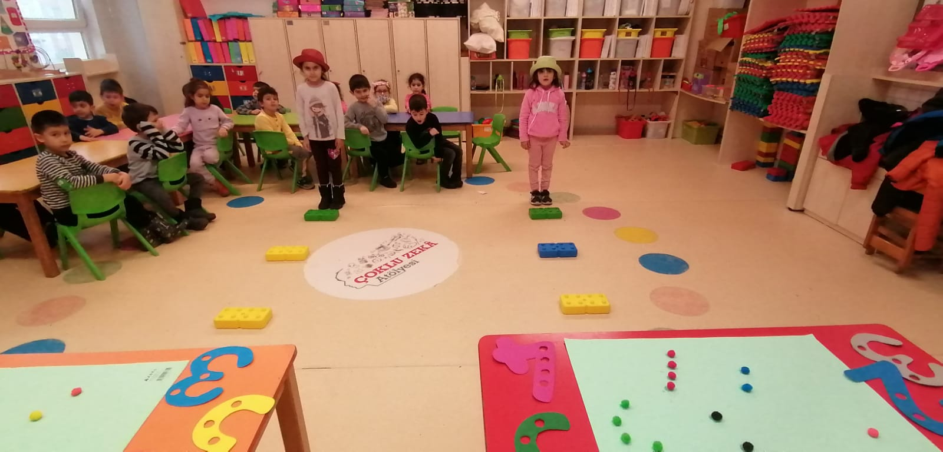

Slide 4
goal: to teach numbers through play.
It is actually an integrated activity. It is both a cognitive and physical activity. support fine hand muscles

Slide 5
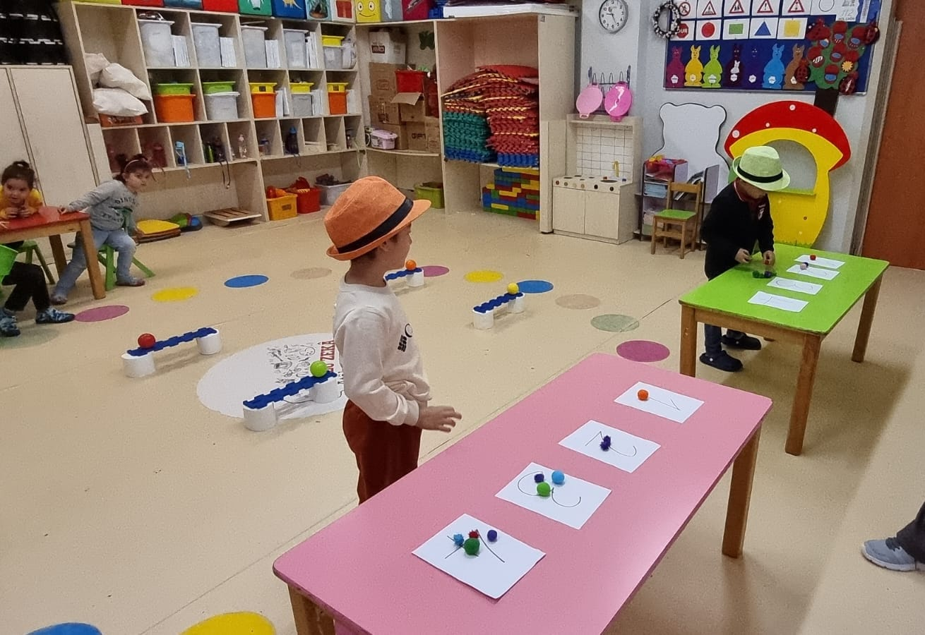
Object and number matching

Slide 6
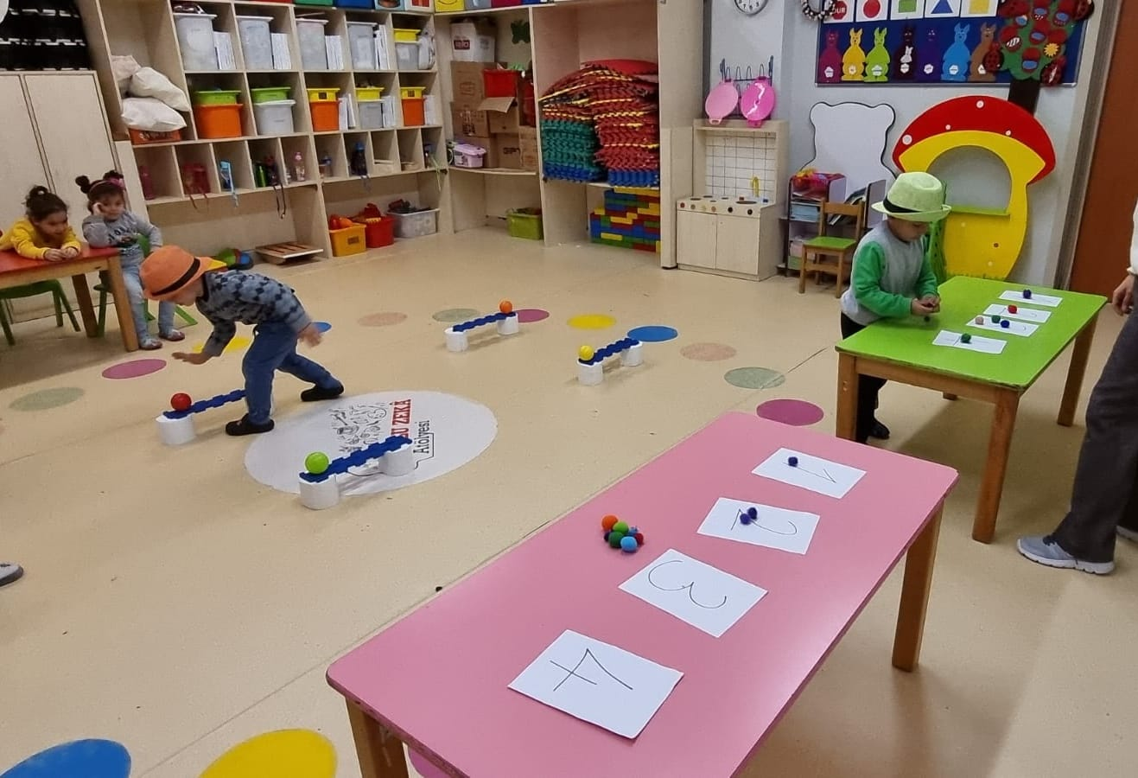

Slide 7
object and number matching
Purpose: It is to help them learn object and number matching by supporting their ability to move through the game.

Slide 8
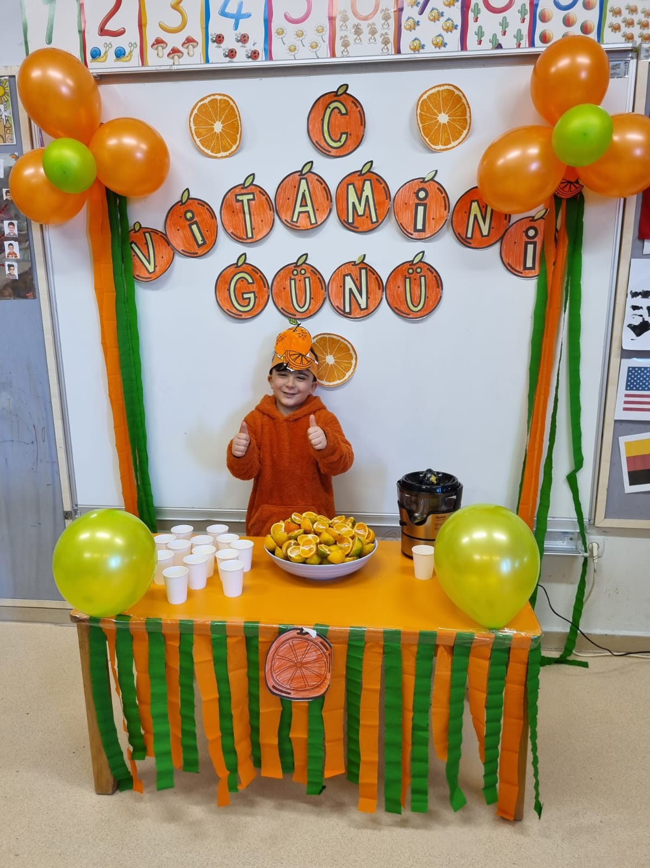
Daily living skills activity

Slide 9
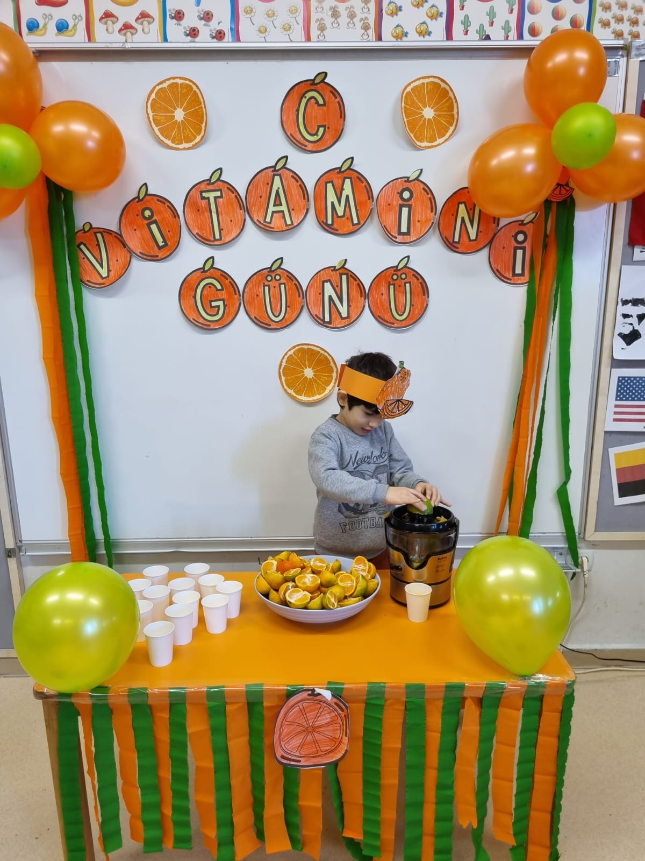

Slide 10
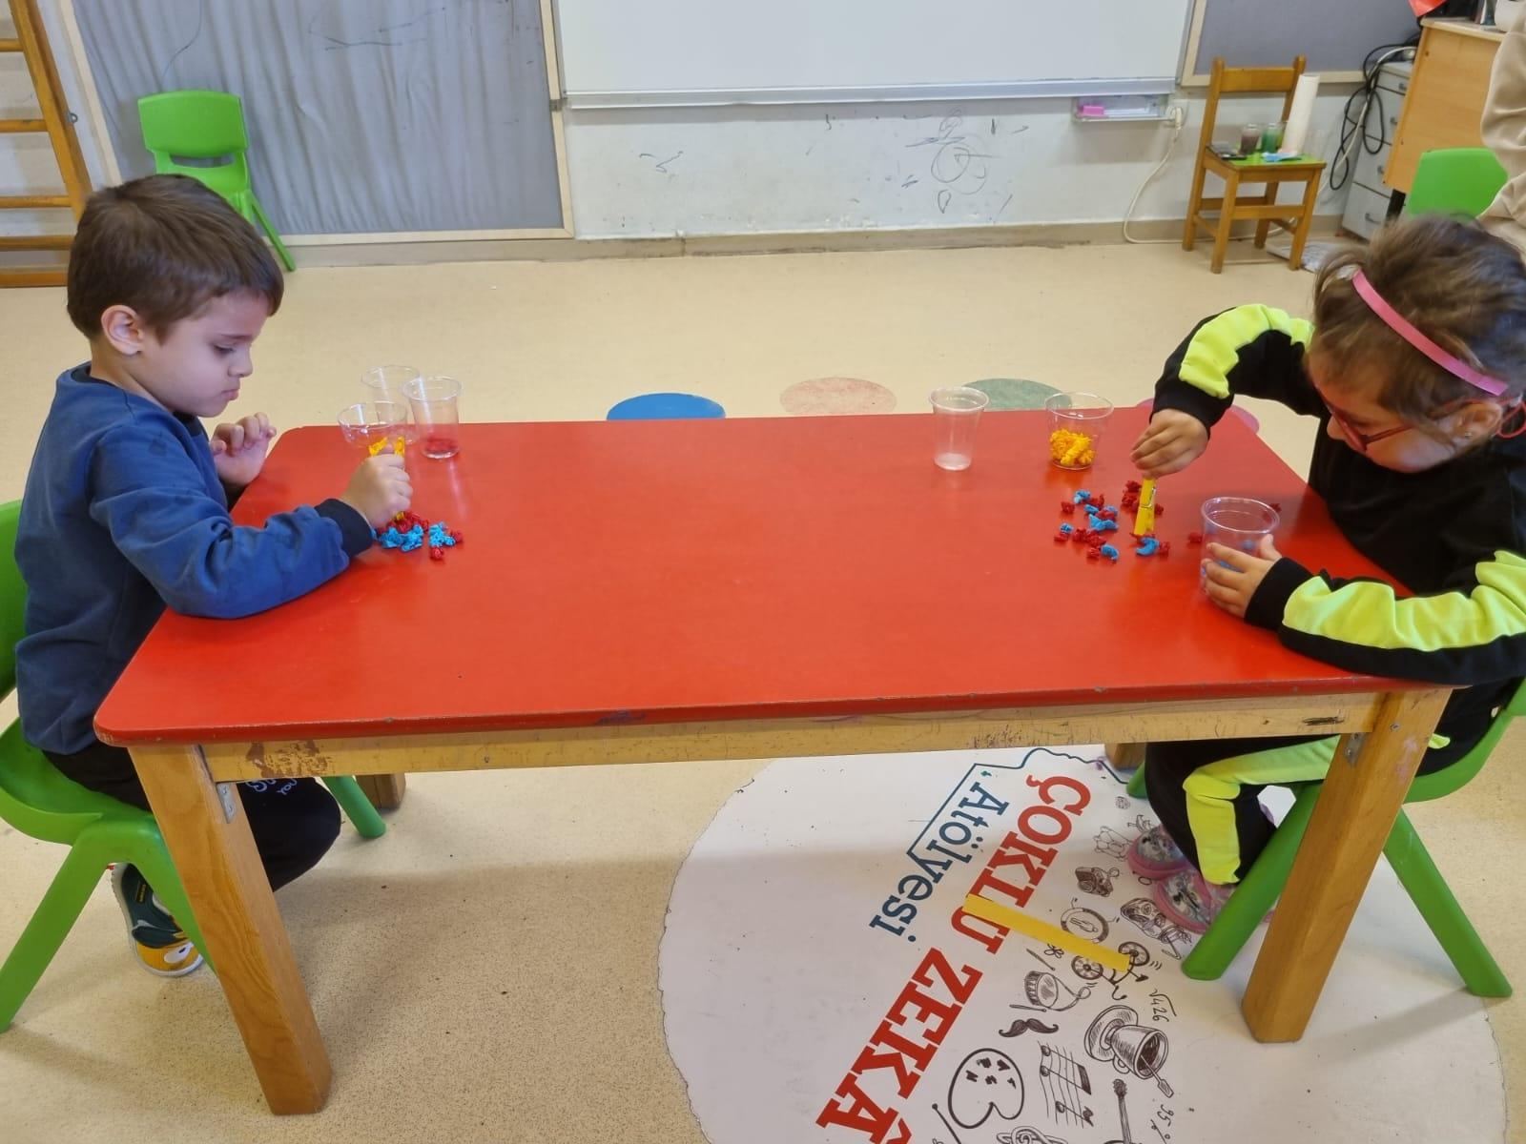
Group by color

Slide 11
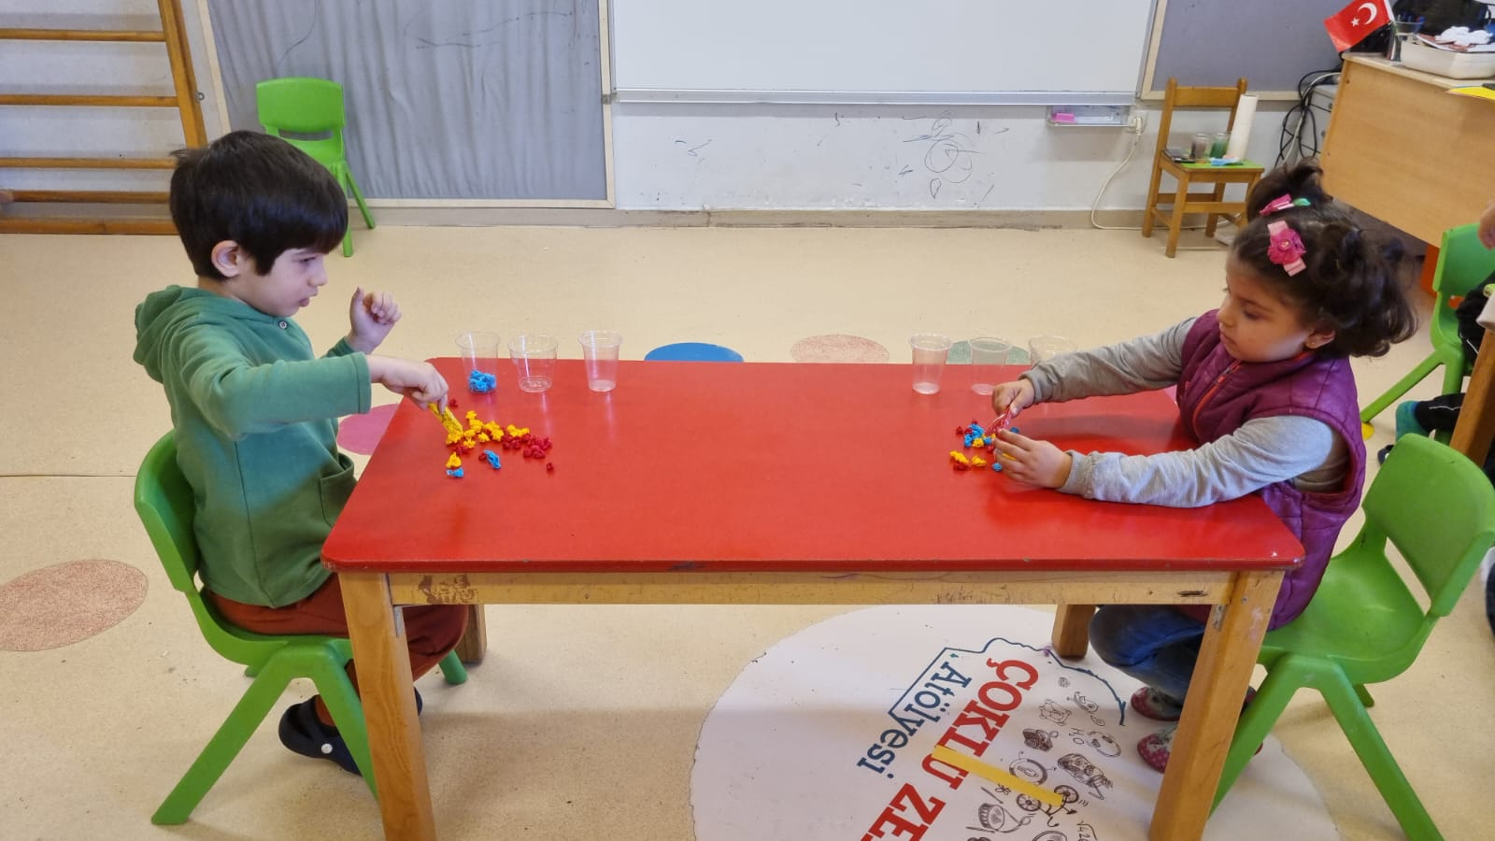

Slide 12
color grouping activity
purpose : to enable children to learn to group colors by having fun and to make quick and correct decisions in an activity.

Slide 13
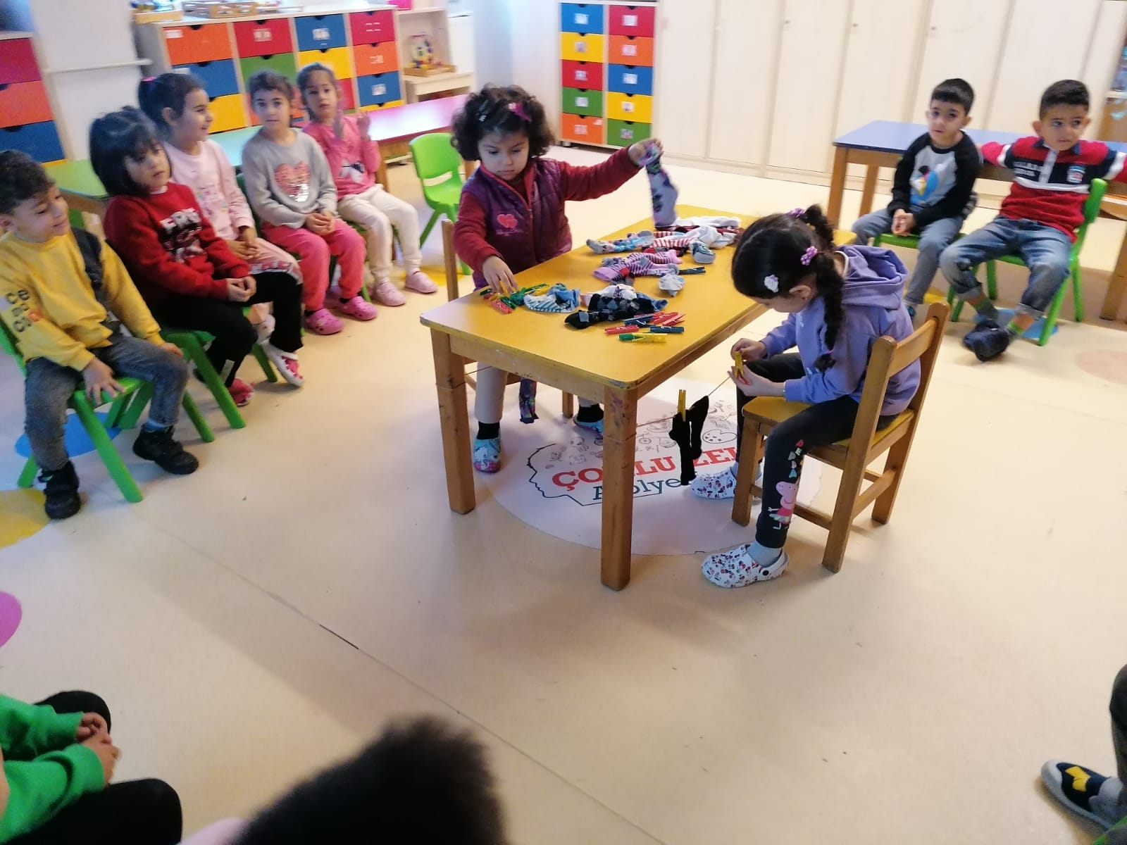
Daily living skills

Slide 14
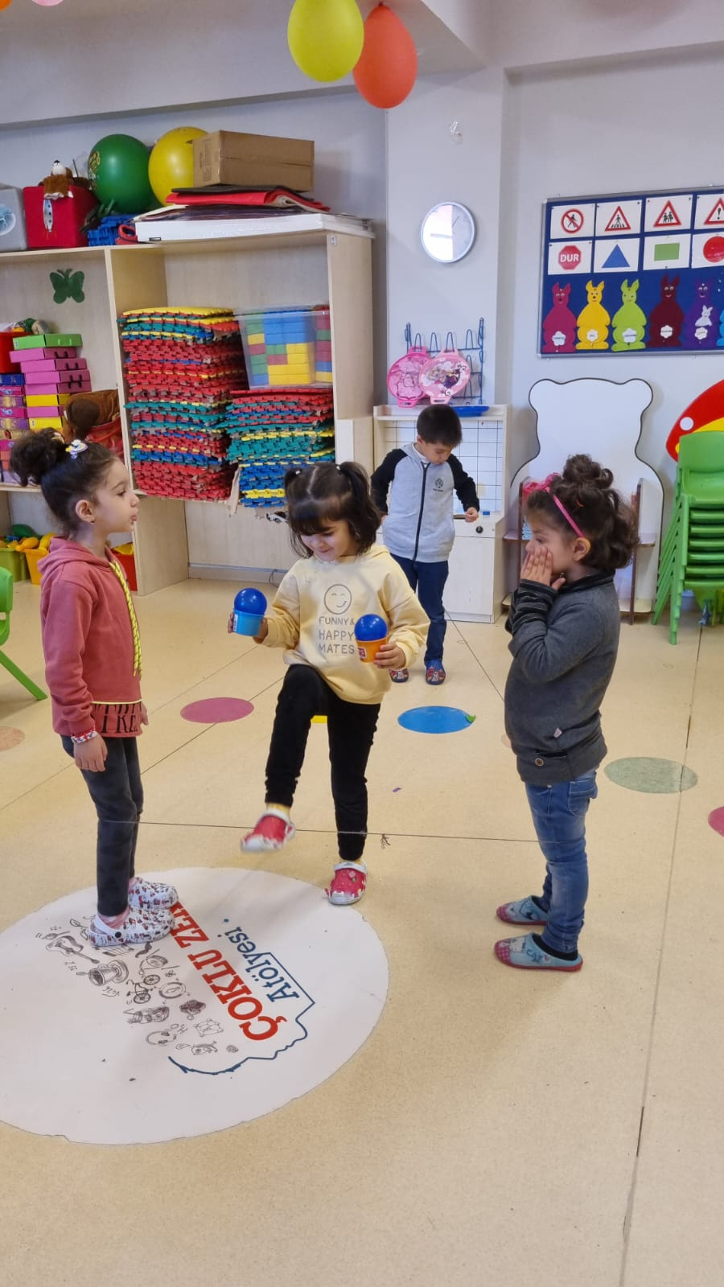
Balance game integrative game / triangle shape concept

Slide 15
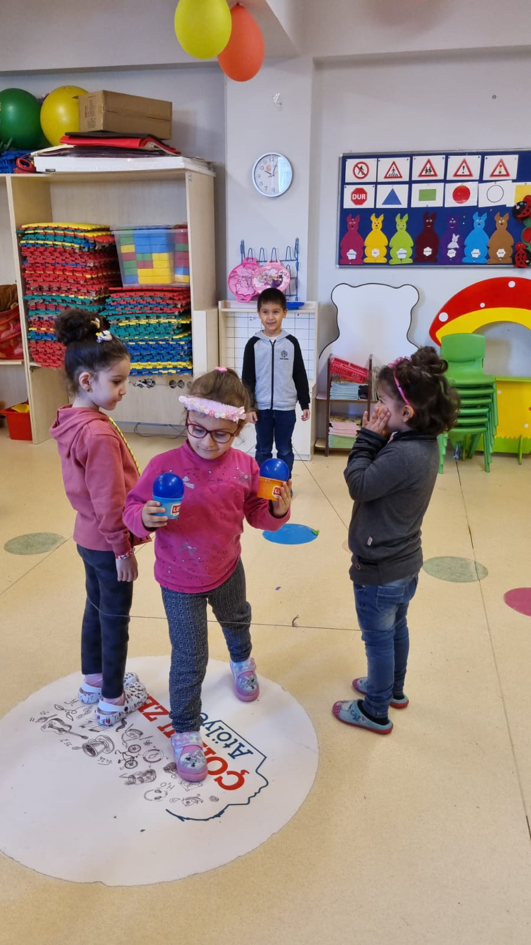

Slide 16
to learn the triangle shape by balancing it.

Slide 17
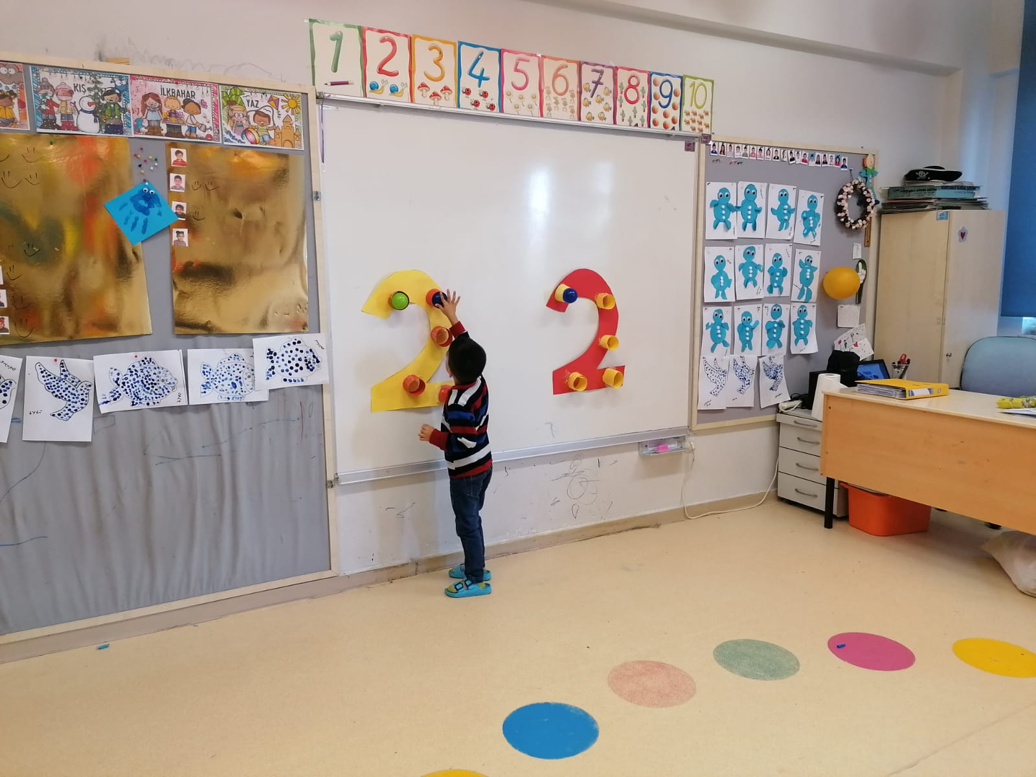
Number two game

Slide 18
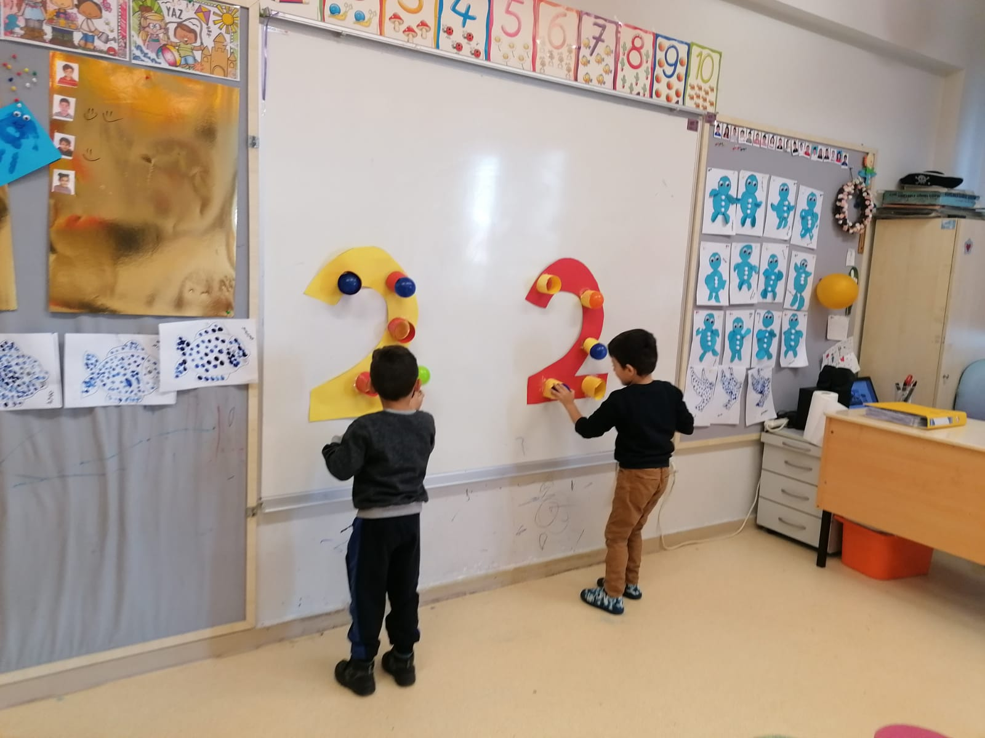

Slide 19
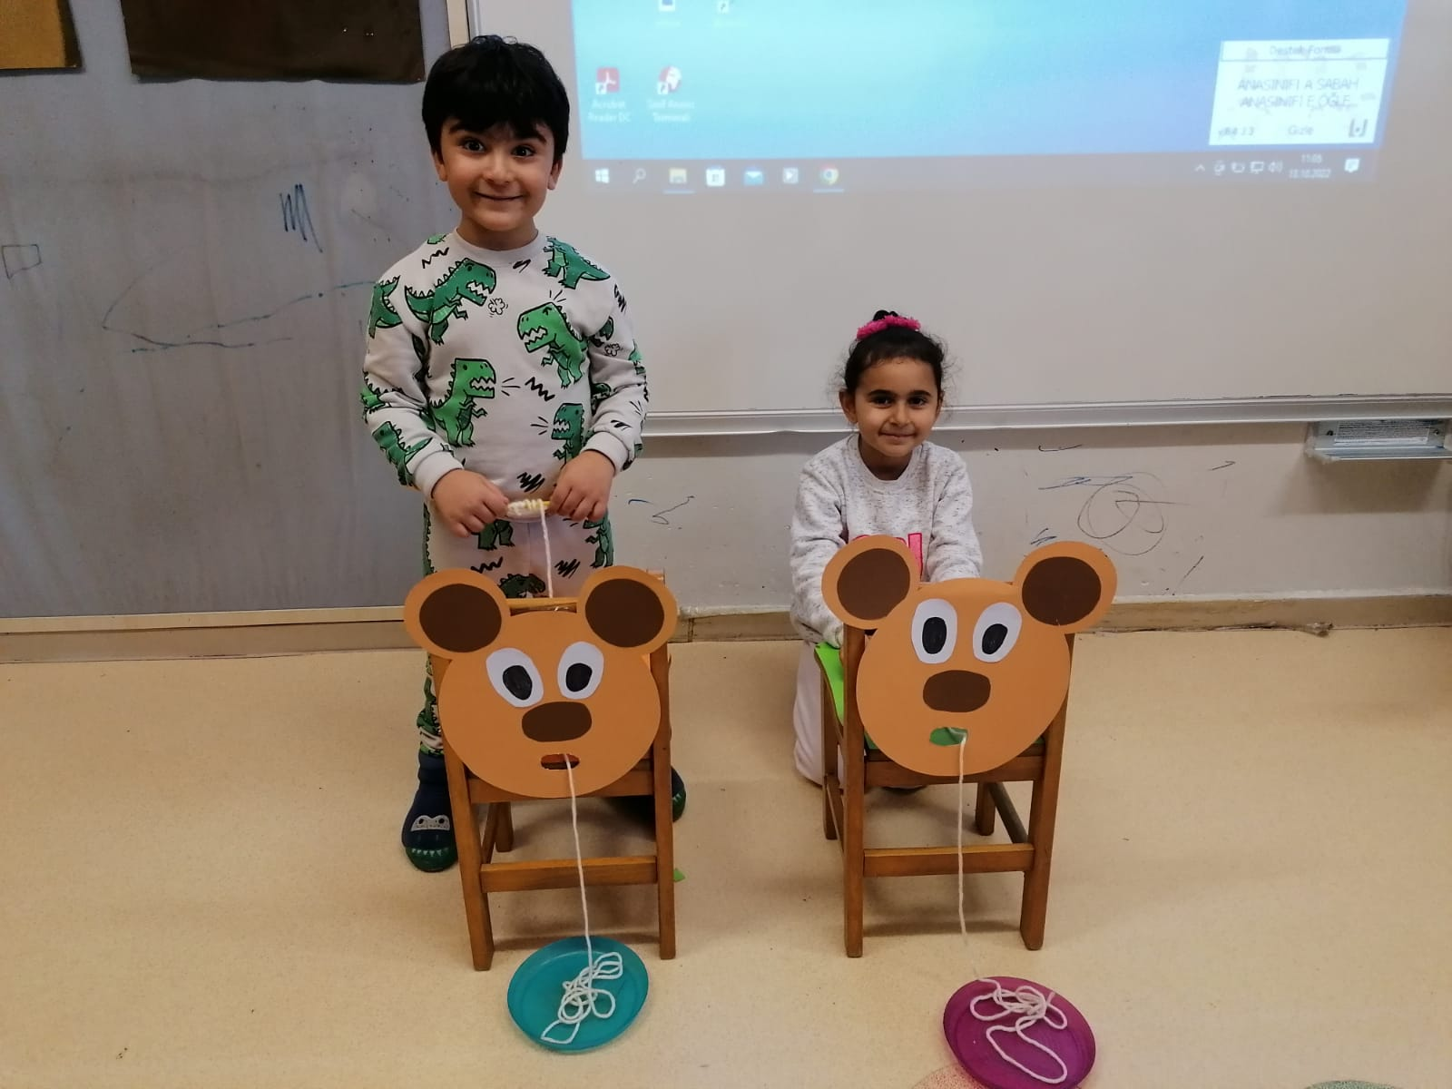

Slide 20
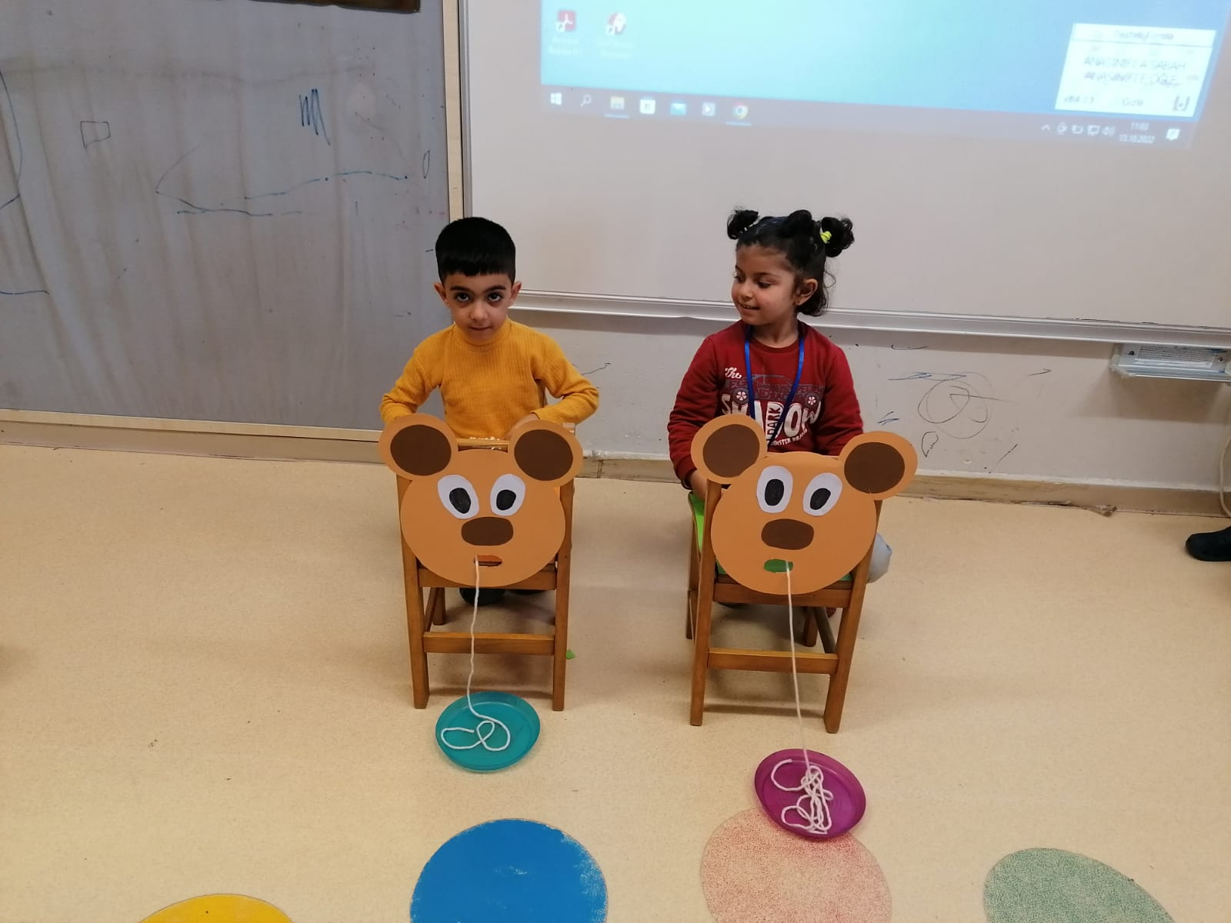

Slide 21
the goal is to be fast and support fine hand muscles

Slide 22
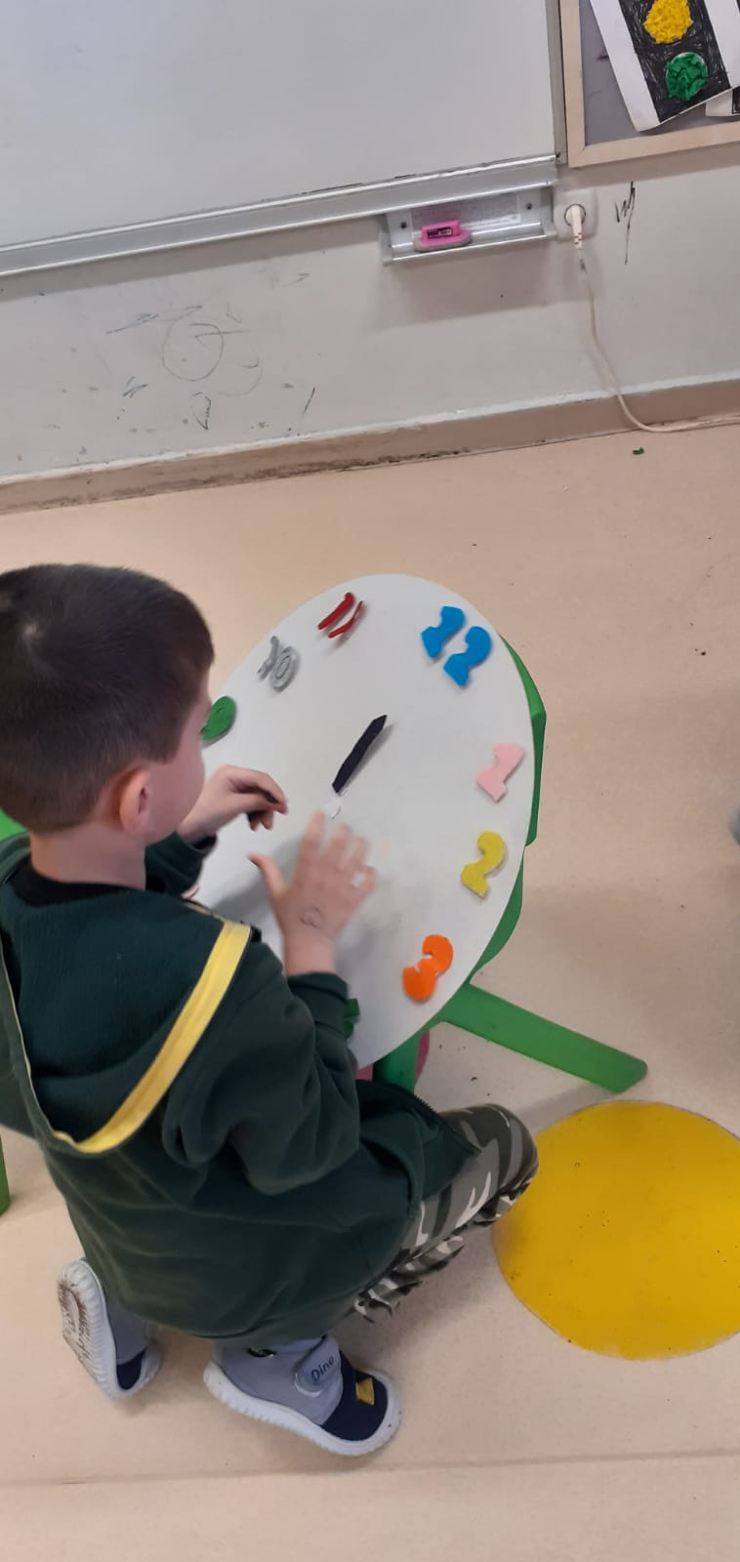
Clock learning activity

Slide 23
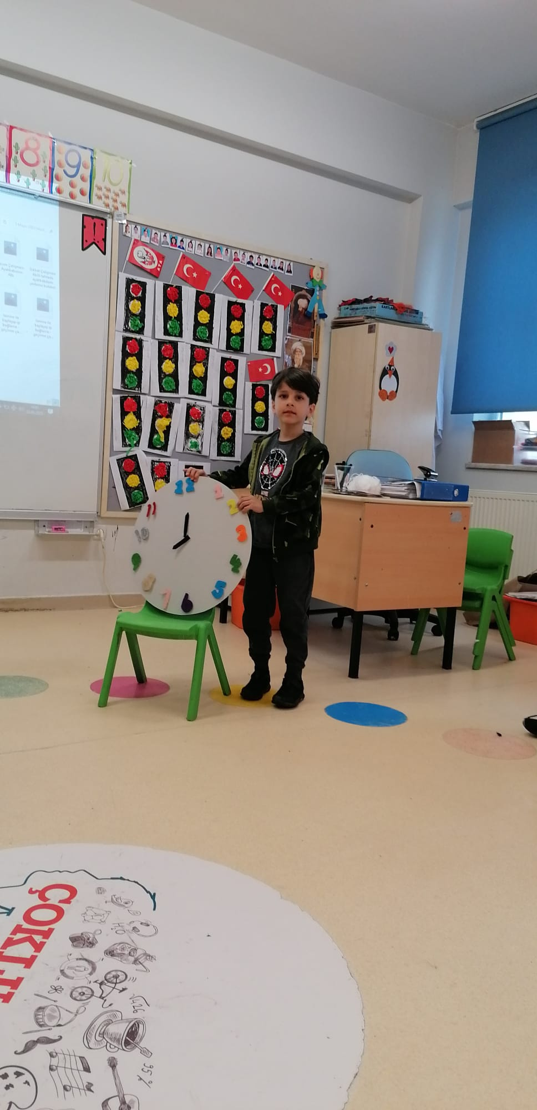

Slide 24
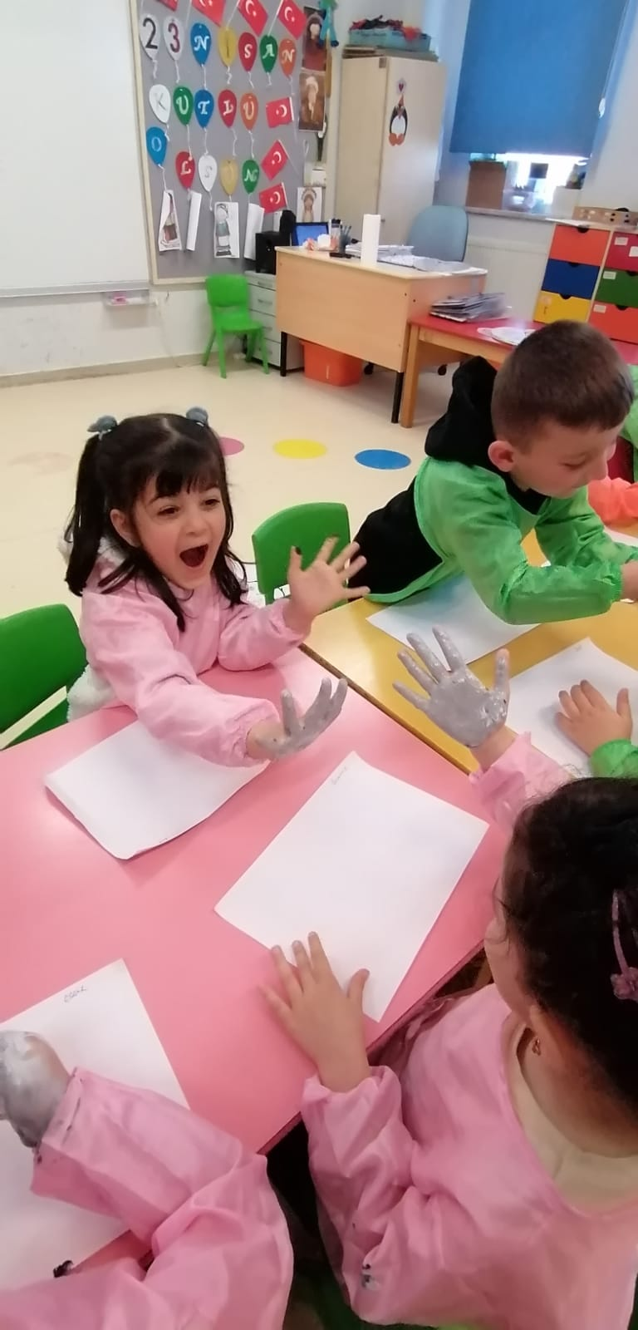
Gray color formation /

Slide 25
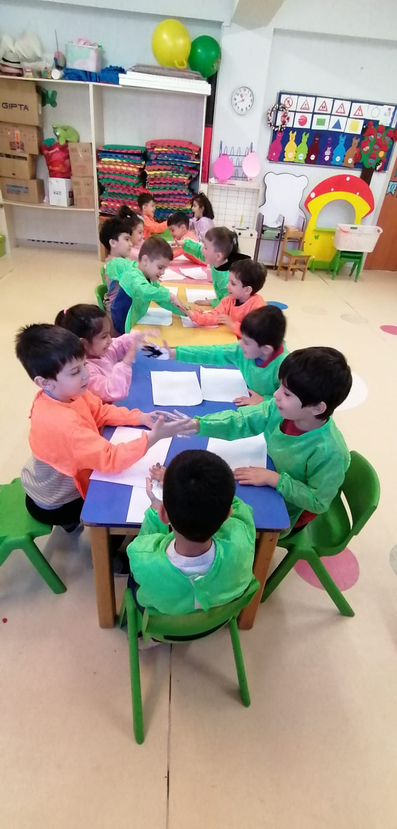

Slide 26
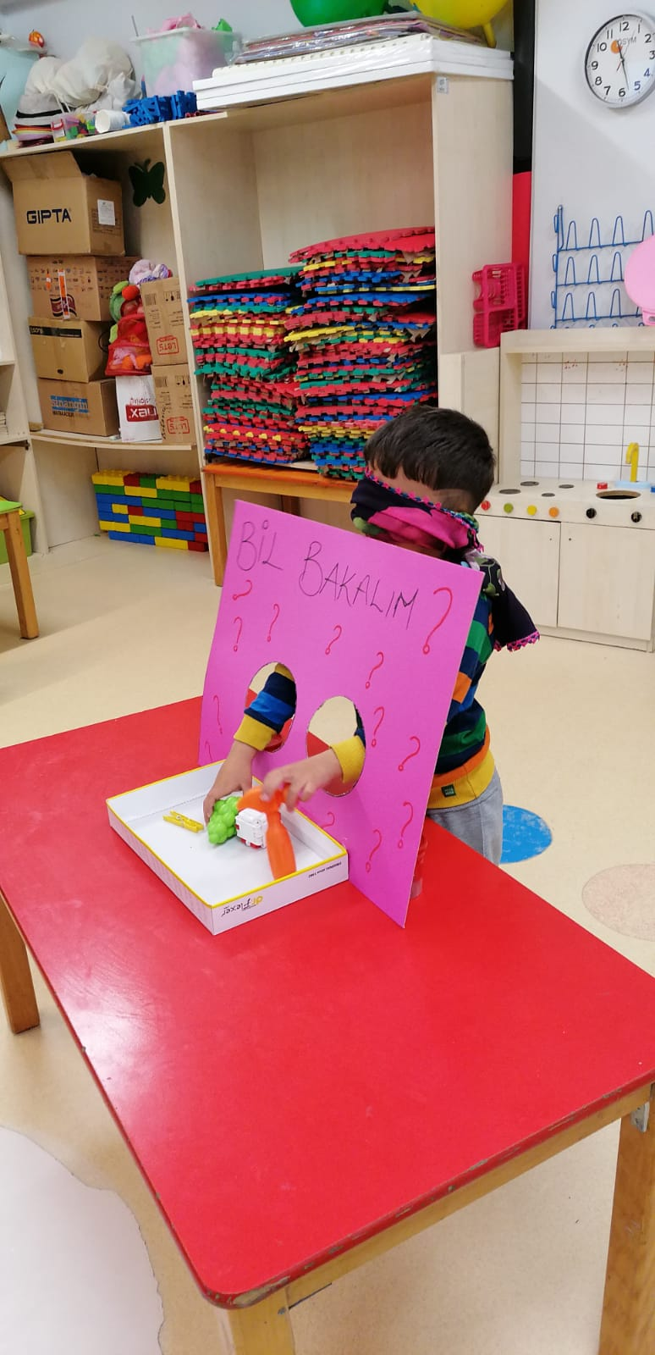
Guess what?

Slide 27
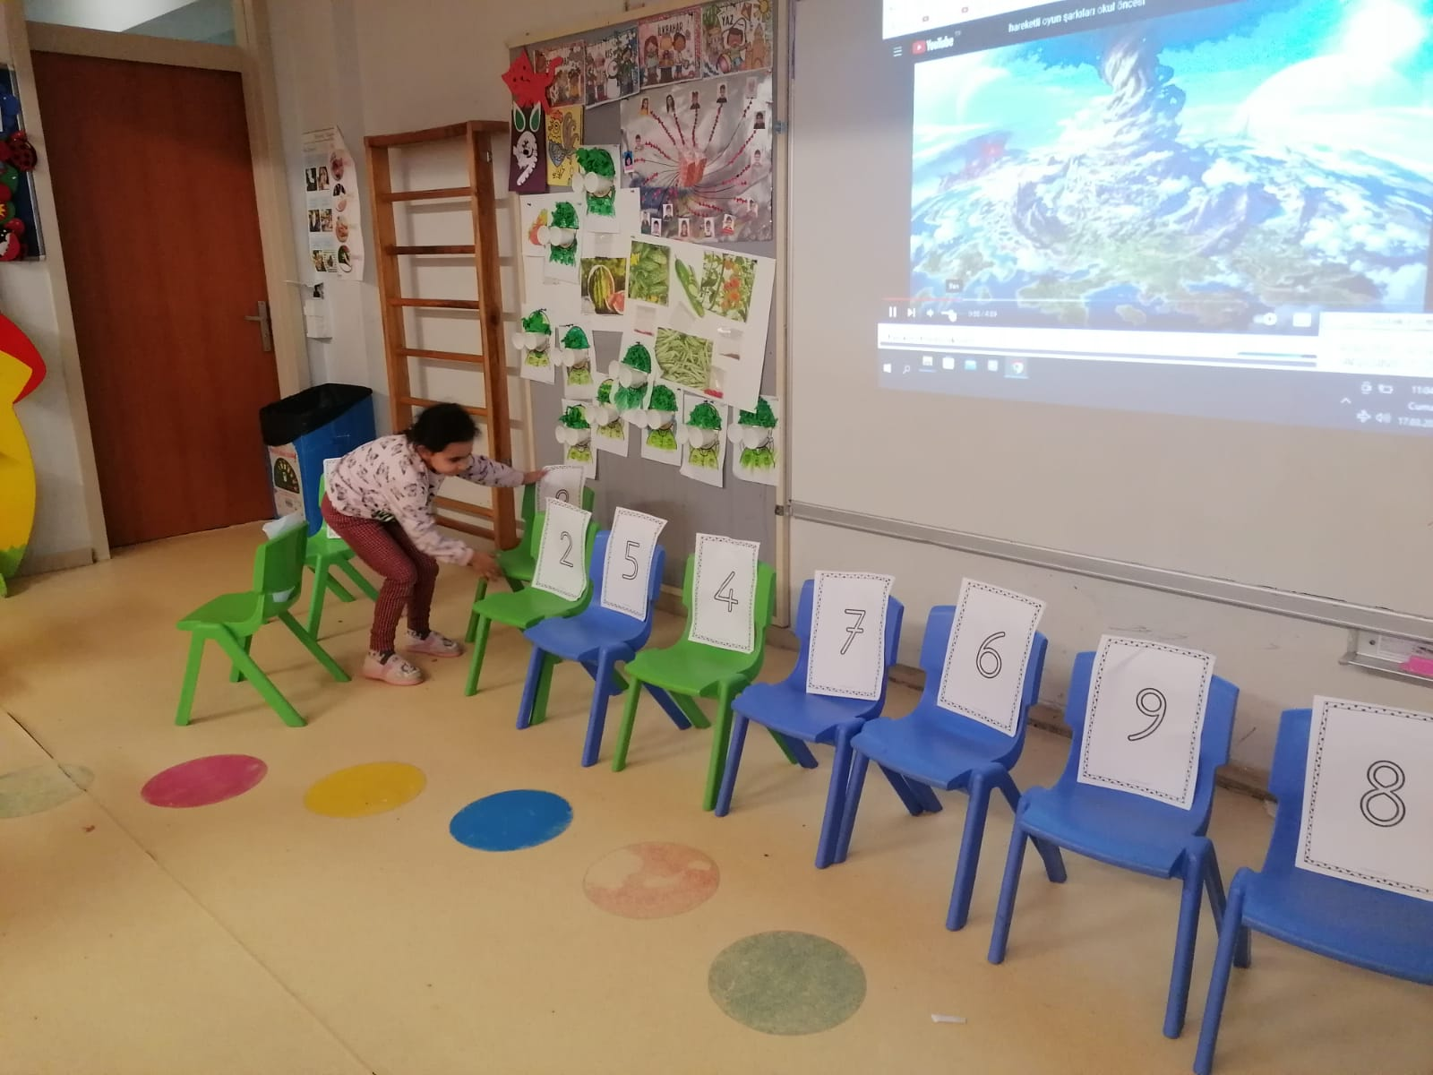
Number sorting game

Slide 28
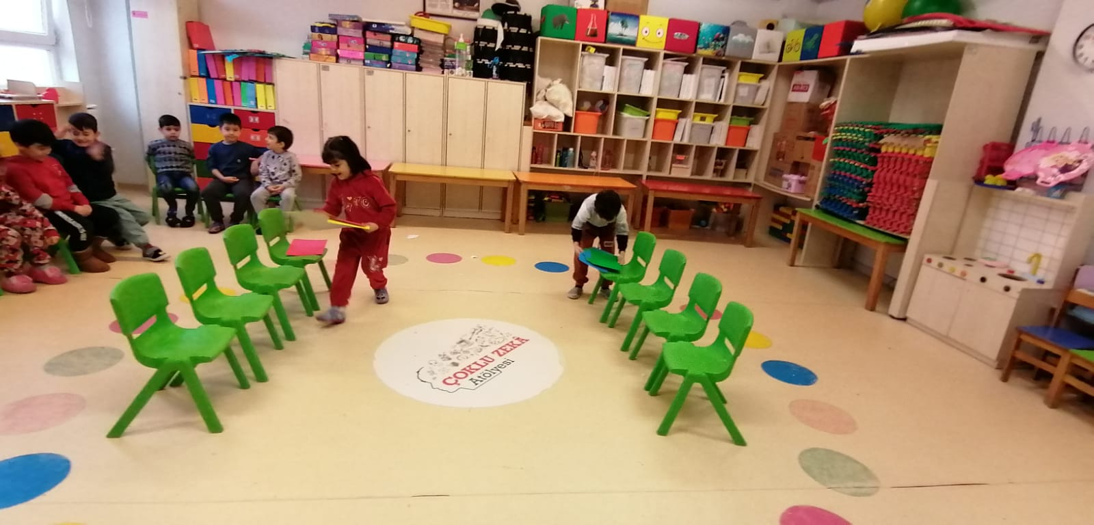
Creating patterns with colored papers

Slide 29
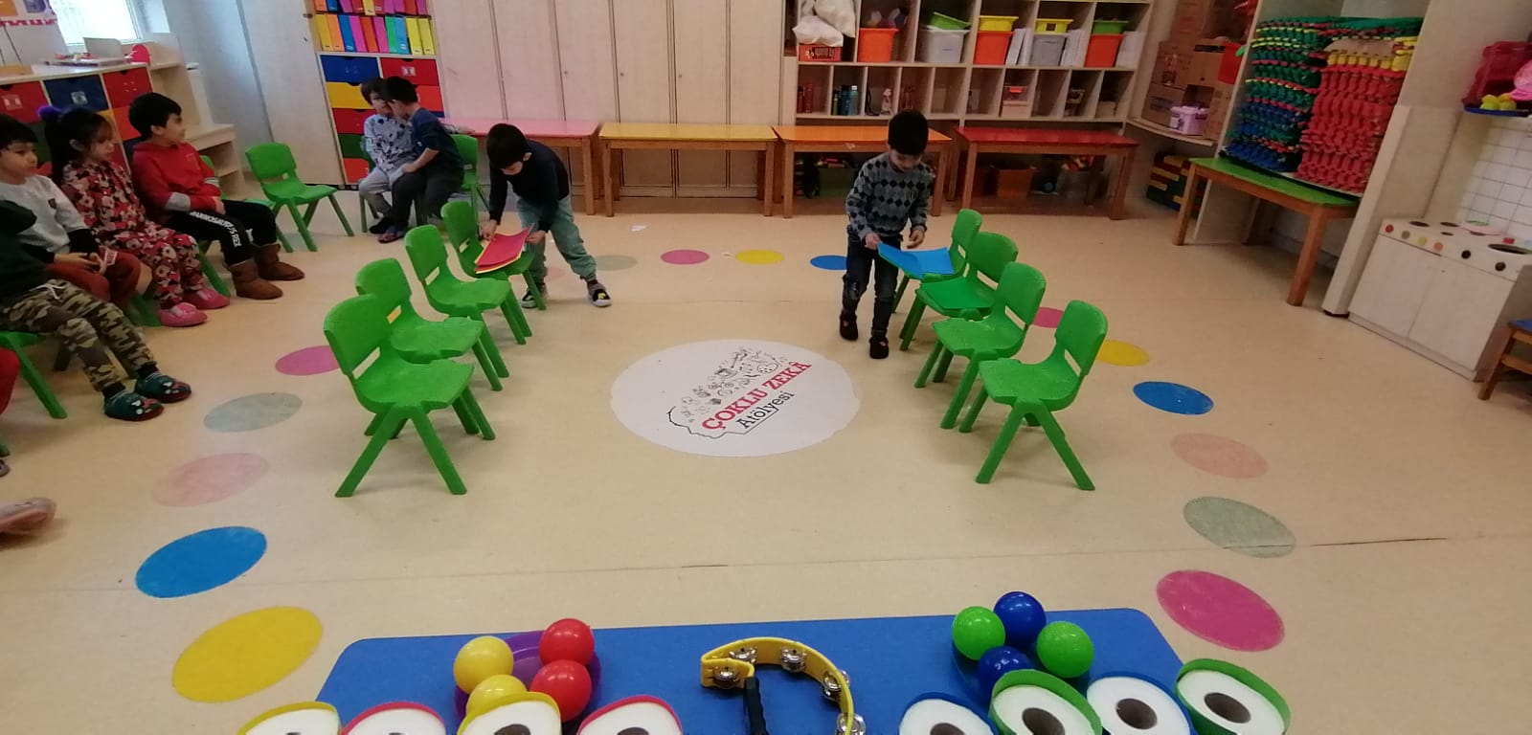

Slide 30
this is a parkour game. The children first proceed by creating patterns on the chair with colored papers, and then they match the balls on the table according to the colors. The one who finishes the game the fastest rings the bell.

Slide 31
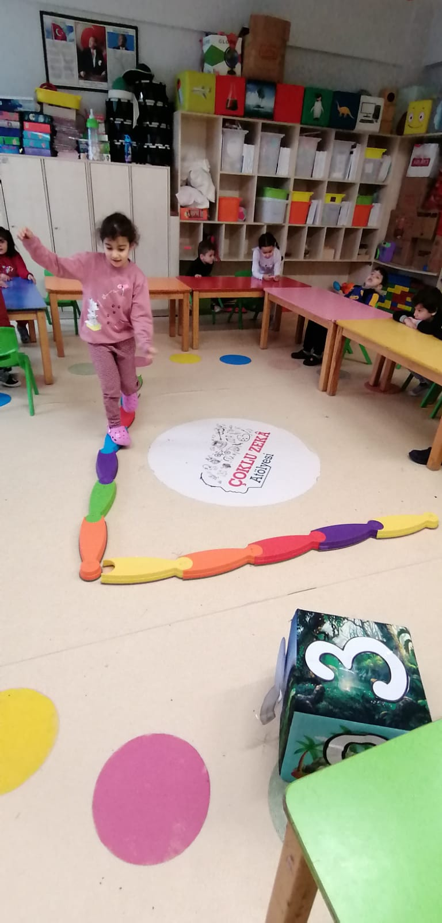
NUMBER SEVEN PARKOUR GAME

Slide 32
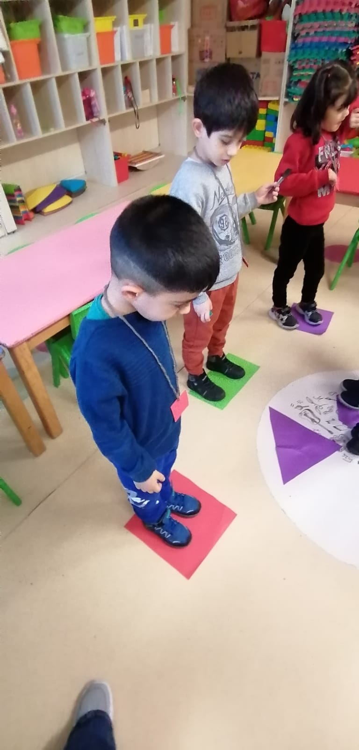
SHAPE FINDER GAME
SQUARE , TRIANGLE , CIRCLE

Slide 33
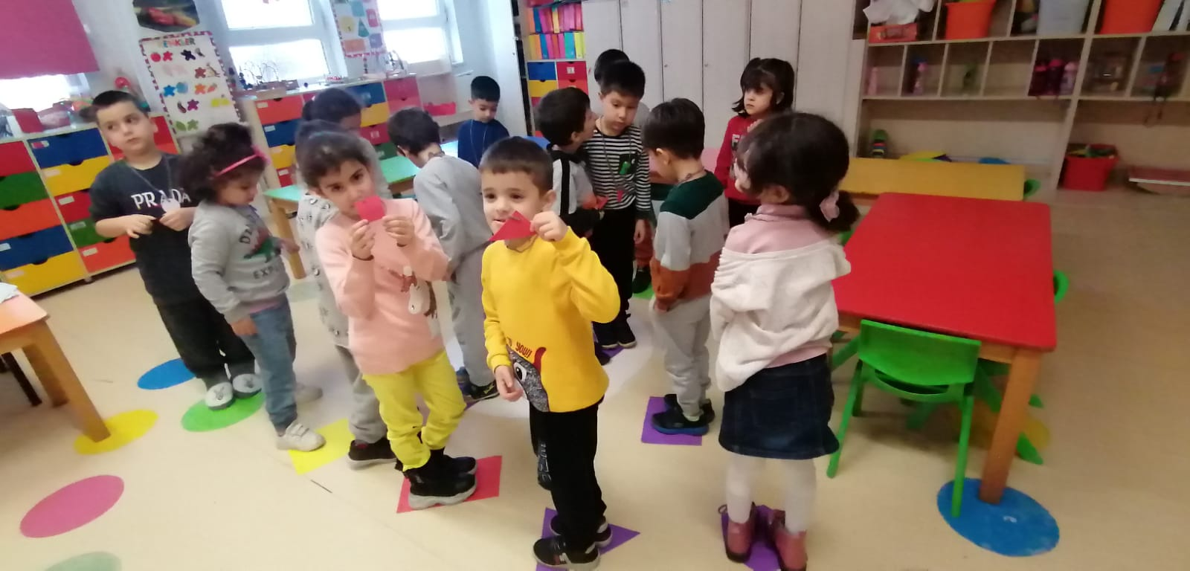
NECKLACES HAVE SHAPES

Slide 34
In this game, children dance when the music is turned on. When the music ends, she tries to find the same geometric shapes on her necklaces on the floor. The game continues with the change of necklaces.

Slide 35
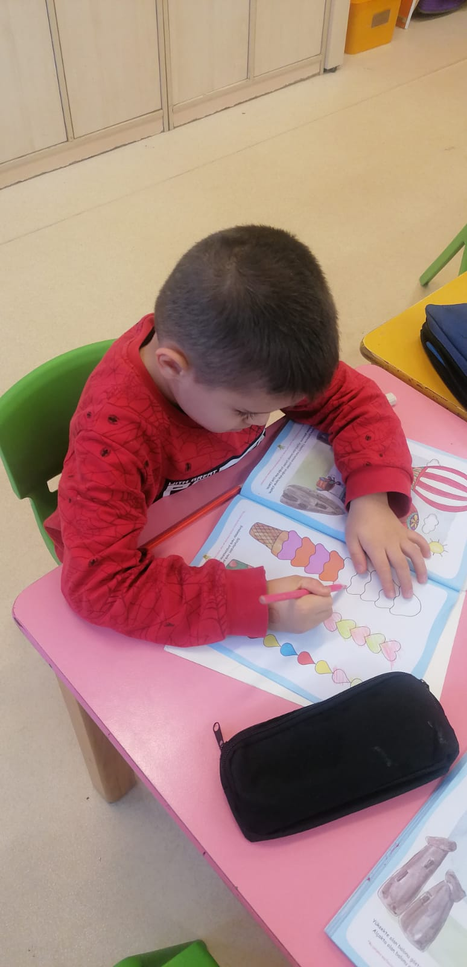
BOOK STUDY

Slide 36
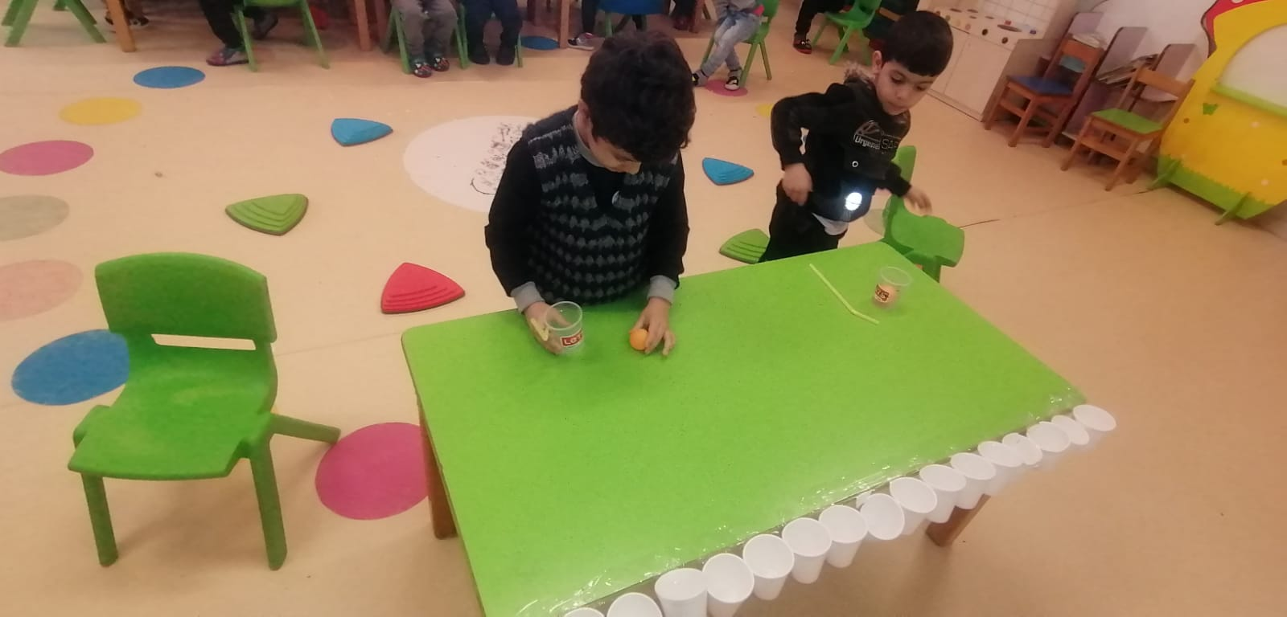
BLOW GAME EVENT

Slide 37
The general purpose of these activities is to support children's learning by having fun and active participation in accordance with the aim of learning through gamification, which is the subject of the project.

Slide 38
END..☺

