Slide 1
LEARNING WITH VISUAL AIDS
PROF. ÎNV. PREȘC. SALE PATRICIA
PROF. ÎNV. PREȘC. ZUBCU ANA
GRĂDINIȚA P.P. NR. 36 TIMIȘOARA

Slide 2
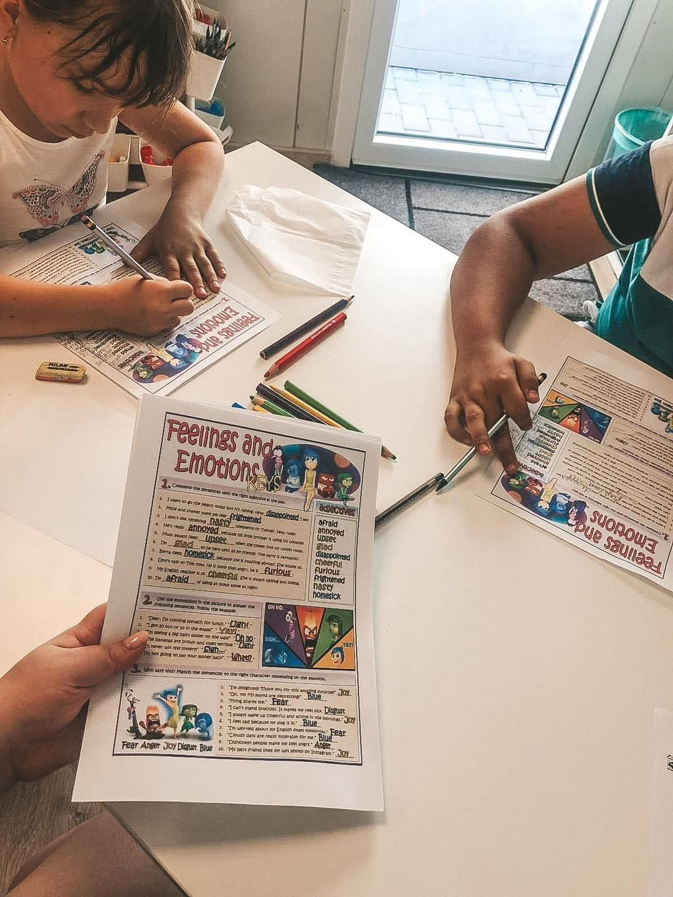
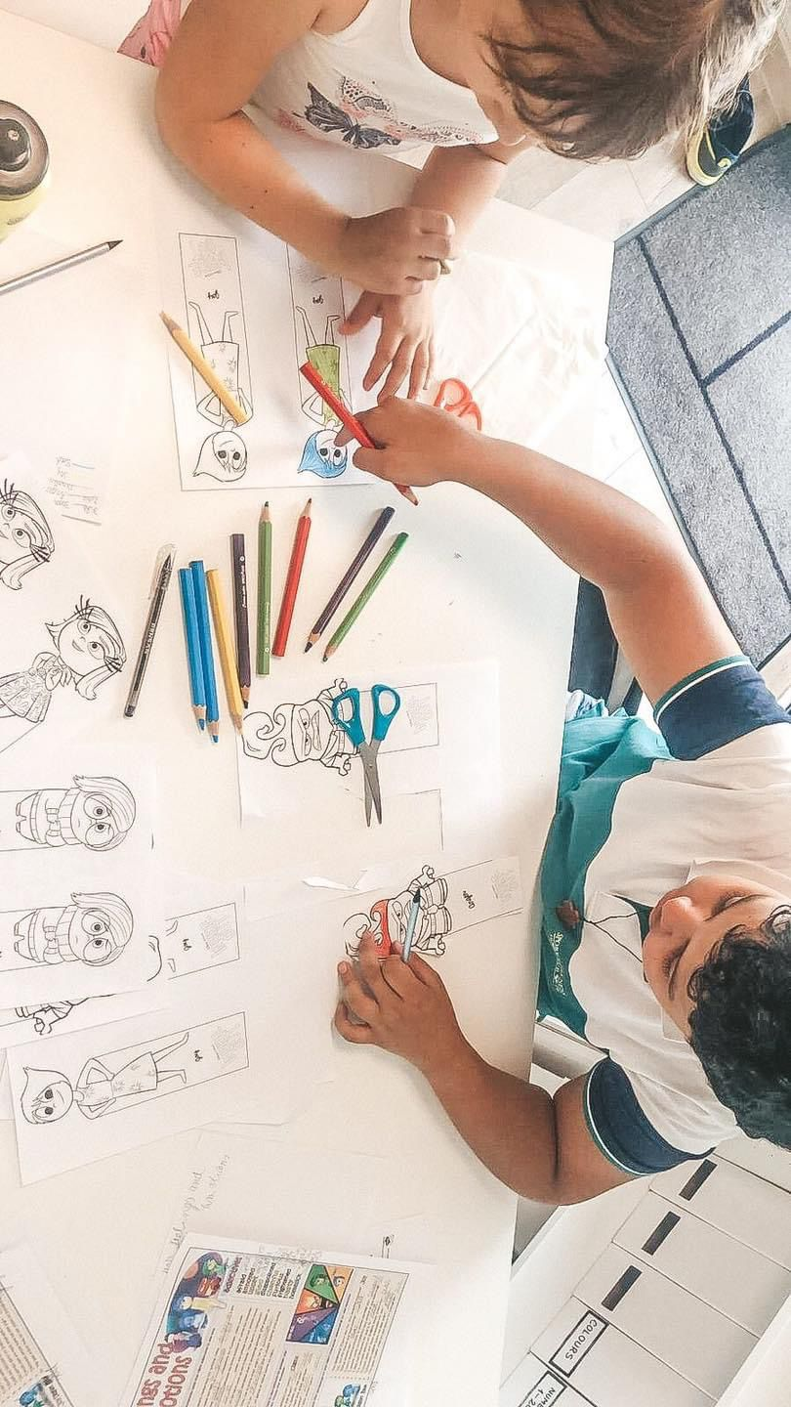
NAME OF THE ACTIVITY: LEARNING WITH VISUAL AIDS

Slide 3
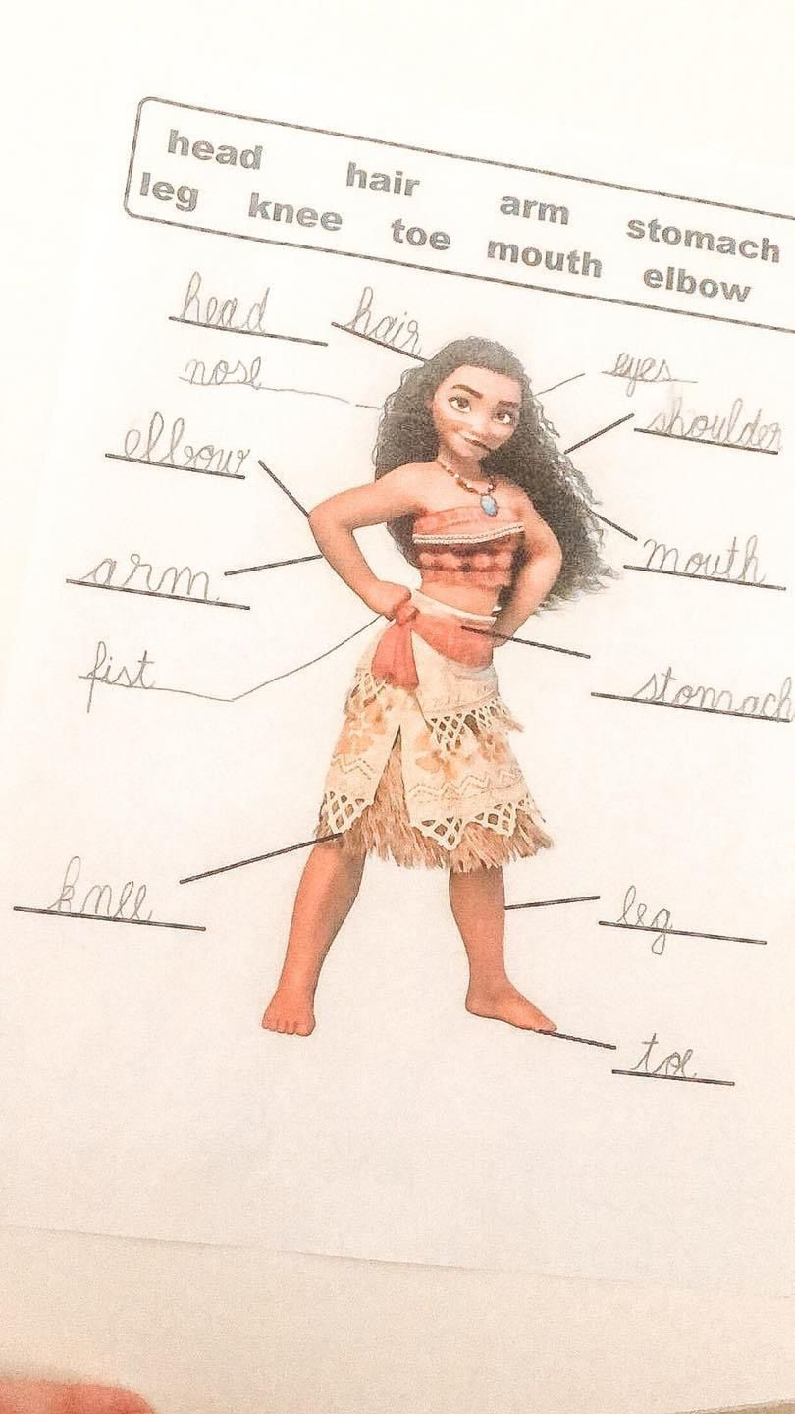
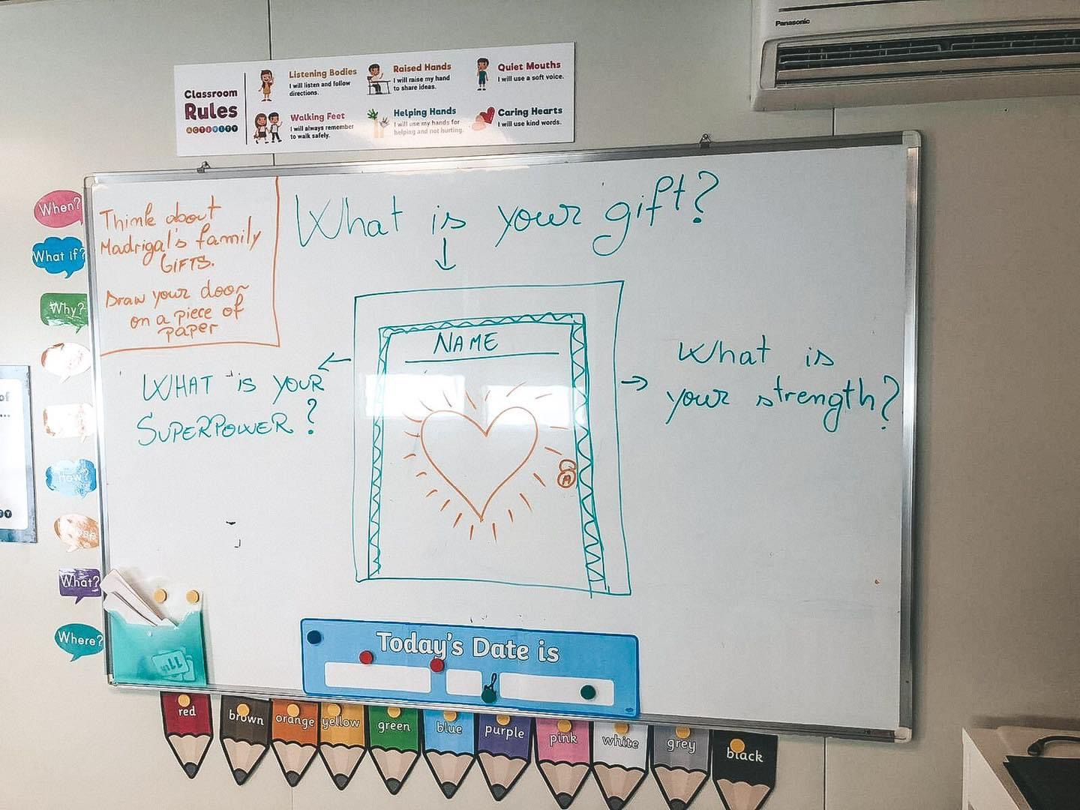

Slide 4
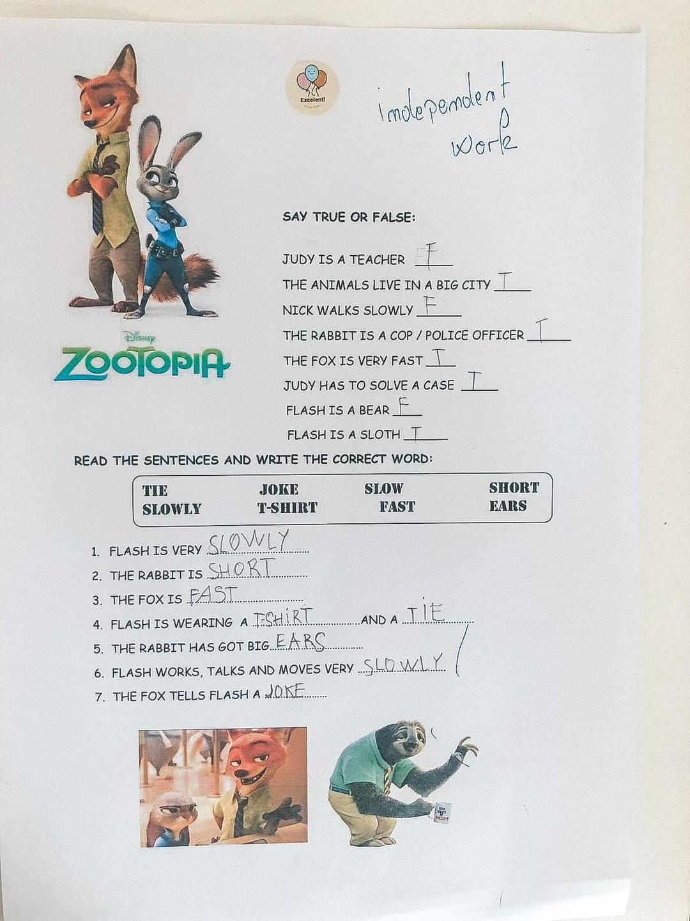
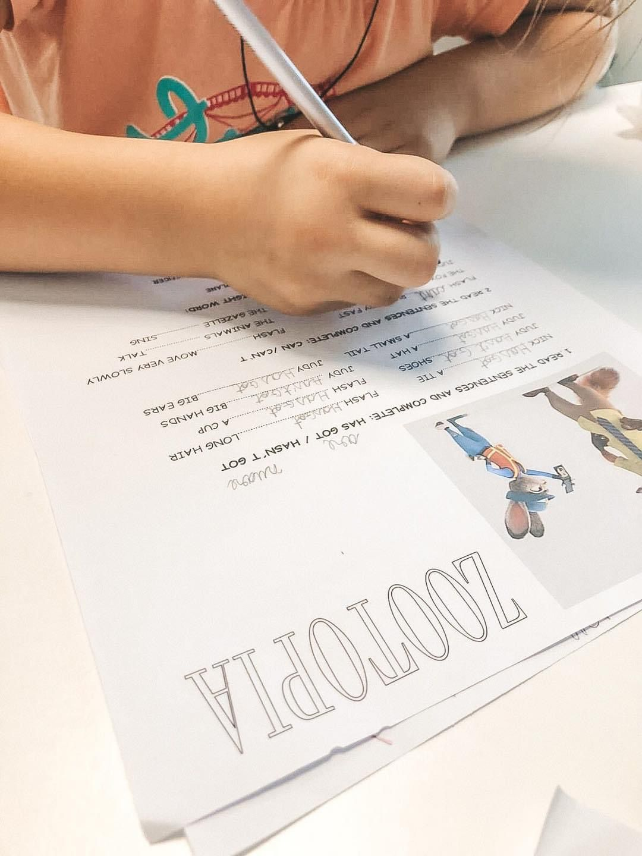

Slide 5
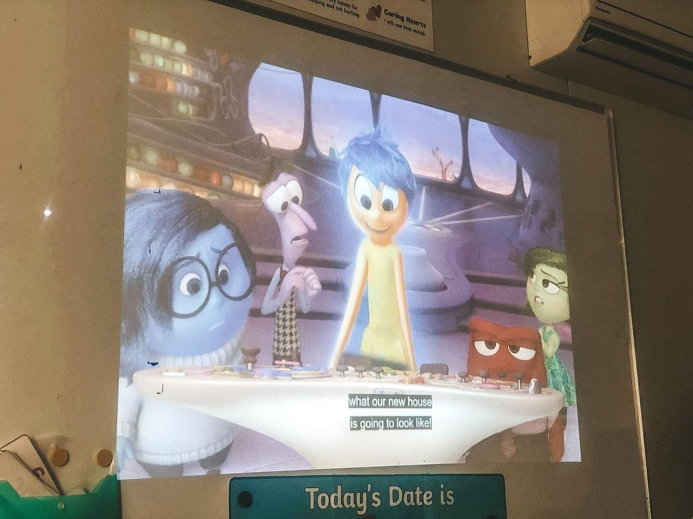
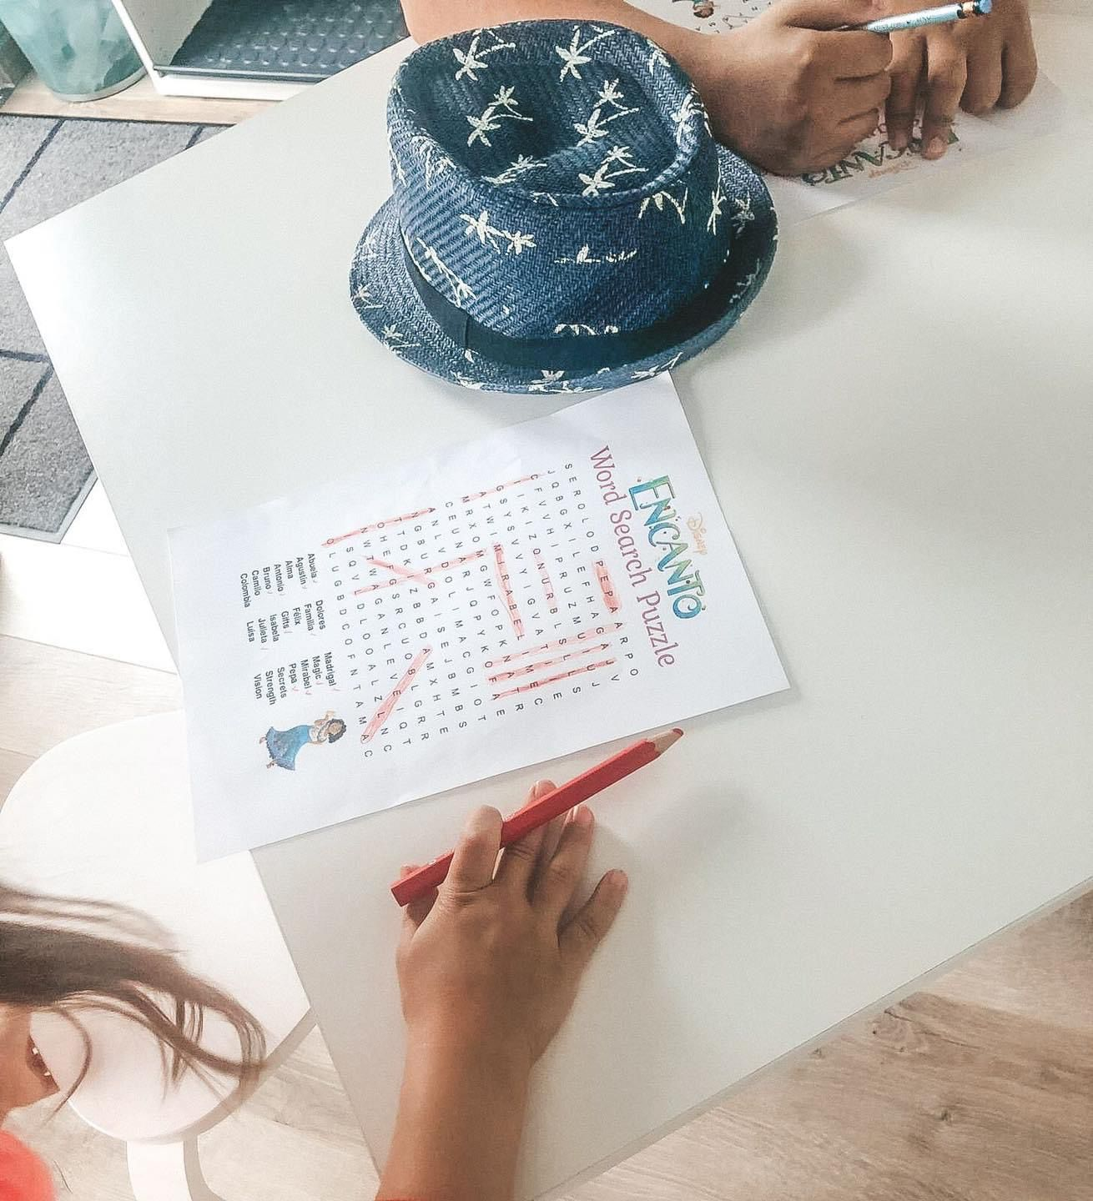

Slide 6
GRADE/AGE GROUP: 10-14 YEAR OLD CHILDREN
SUBJECT: ENGLISH
AIM OF THE ACTIVITY:
During this activity, children will learn the parts of the body, degrees of comparison of adjectives, new expressions and at the same time they will enrich their vocabulary.
The purpose of this activity is to activate the cognitive function and to stimulate it in a fun way, by means of the Disney movies that children and adults love regardless of their age.

Slide 7
MATERIALS NEEDED FOR THE ACTIVITY:
worksheets, colored pencils, colored markers, Disney movies, smart board, video projector, laptop, classroom, markers, speakers, camera, projection screen, diplomas.
LENGTH OF THE ACTIVITY:
The activity can take place during 90 minutes or can be extended during a course day, respectively 240 minutes.
NUMBER OF PARTICIPANTS:
A classroom of 12 children.

Slide 8
DESCRIPTION OF THE ACTIVITY
The proposed activity takes place during one course day, i.e. 4 hours. The day begins by welcoming the children to the classroom, they are expected at tables with various recreational activities and games, but through which they can develop their cognitive functions. One morning we wait for them with books, other mornings with relaxing music and plasticine, because fine motor skills are important even for older children.

Slide 9
In the introduction of the course, we will start with the projection of Disney films, and during the viewing, the film will be paused and we will discuss various aspects related to the activities that will follow during the day.
Some of the questions asked: What are adjectives? Give some examples that you have heard. Who are the characters of the movie Encanto? What is the action of the movie Zootopia? What does Moana look like? Describe the character through some physical and moral traits.

Slide 10
After watching the Disney movies, the children receive independent worksheets that they will work on individually, thus using the information accumulated after watching the movies.
Visual aids are meant to stimulate children's creativity, so learning can be fun.
After watching the movie Encanto, the children receive a puzzle-type sheet where they will discover the names of the characters they saw. Through the movie Zootopia, they will complete exercises with has got and hasn't got, can and can t based on the information in the movie. The sentences contain information from the film, so completing them will be simple and easy to do because the children were attentive throughout the viewing.

Slide 11
TIPS AND RECOMMENDATIONS
Here are some links for the worksheets we used:
https://www.liveworksheets.com/ru1987768xu
https://en.islcollective.com/english-esl-worksheets/listening-comprehension/video-or-movie-activity/zootopia-trailer/87364
https://en.islcollective.com/english-esl-worksheets/listening-comprehension/video-or-movie-activity/zootopia-trailer-activities/87367
https://en.islcollective.com/english-esl-worksheets/speaking-practice/picture-description/body-parts/moana-body-parts/113251
https://www.puzzletainment.com/moana-word-search/?utm_content=cmp-true

Slide 12
Also, i recommend using other Disney movies for further activities. There are a lot of materials on the internet.
Using visual aids in your class will make it so much fun. The teaching-learning process is much easier, the children easily acquiring information that they normally assimilate with difficulty.
English is a language that all children must know. Through the technology and the resources we have at hand, we can create a fantastic activity that the children will definitely not forget. The key is play and creativity.

