Slide 1
TEACHING THROUGH GAMES
PROF. ÎNV. PREȘC. DAN DANIELA
PROF. ÎNV. PREȘC. PARASCHIV CORINA
GRĂDINIȚA PP 36 TIMIȘOARA

Slide 2
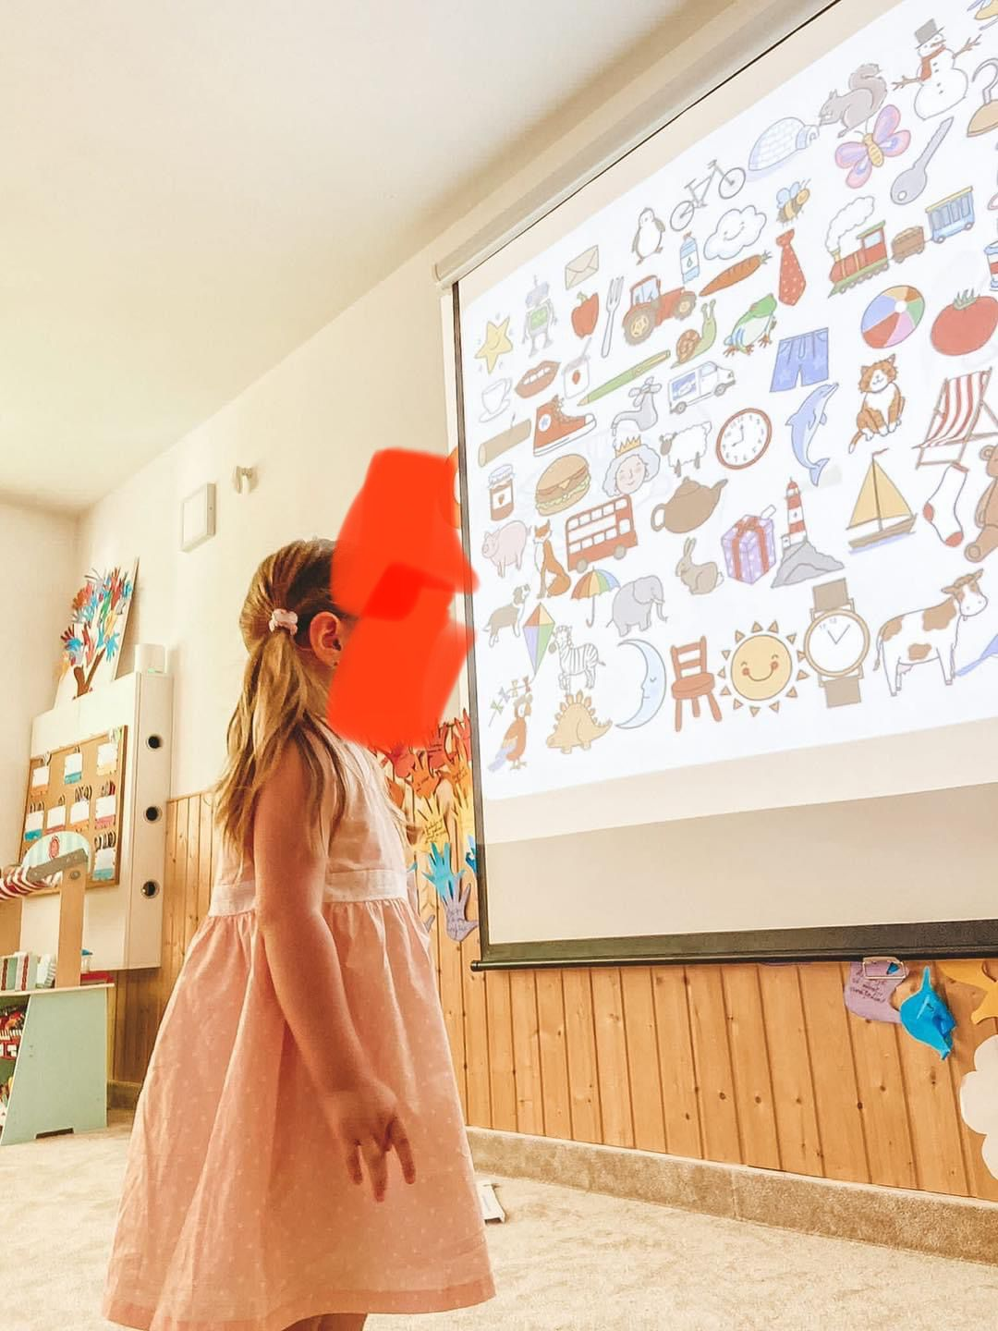
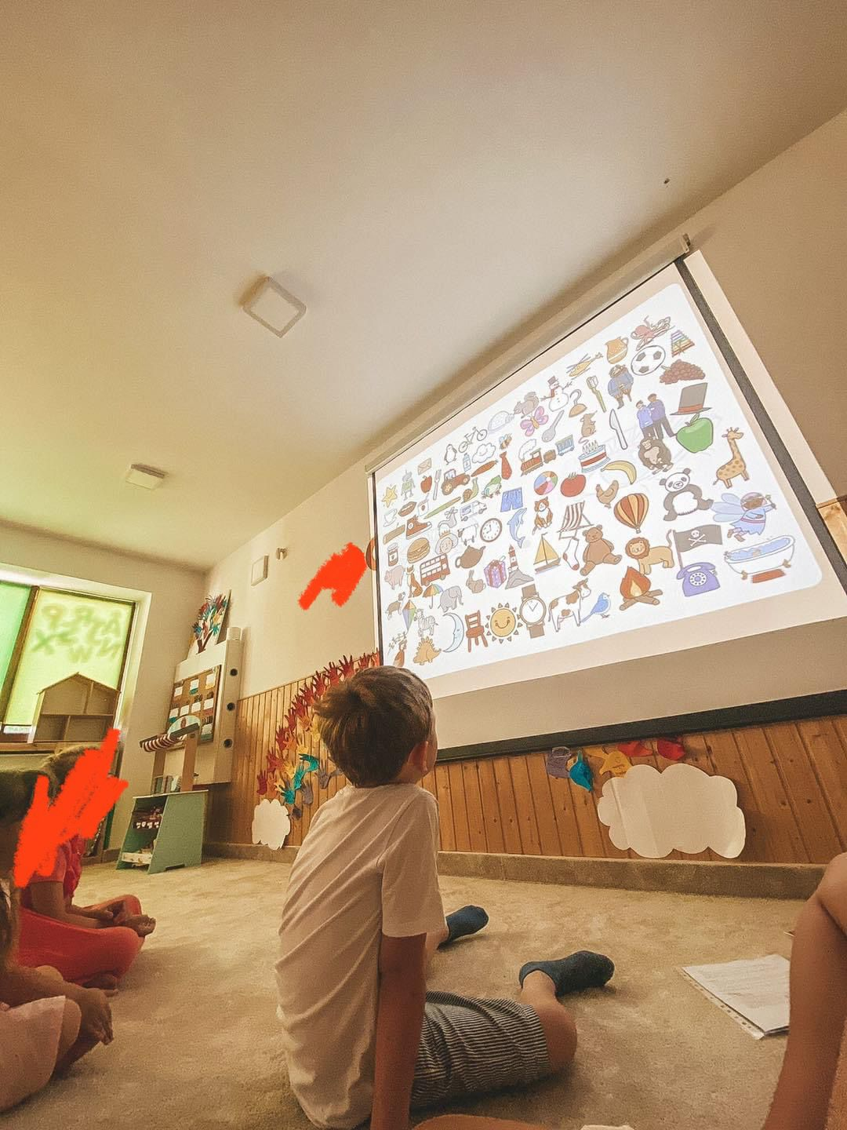
Name of the activity: ”Teaching through games”

Slide 3
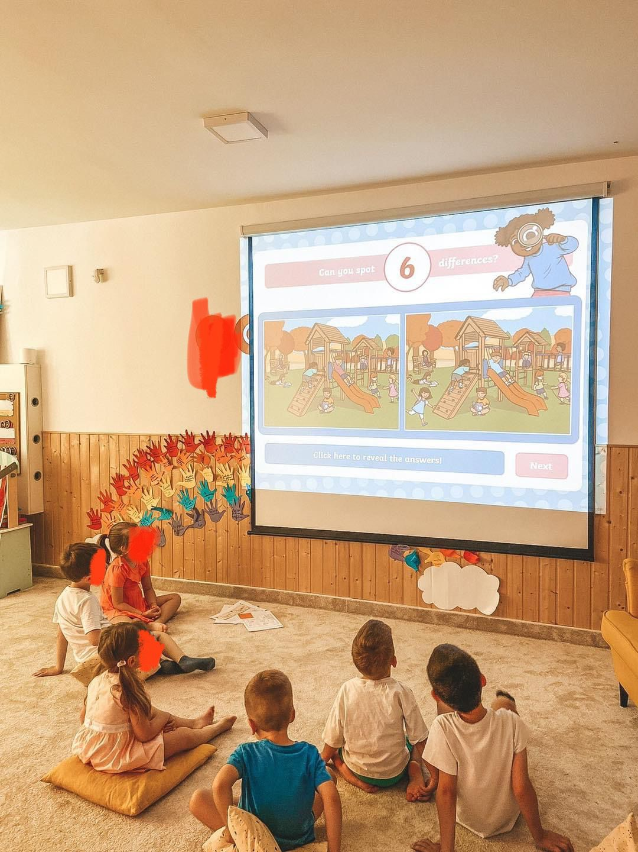
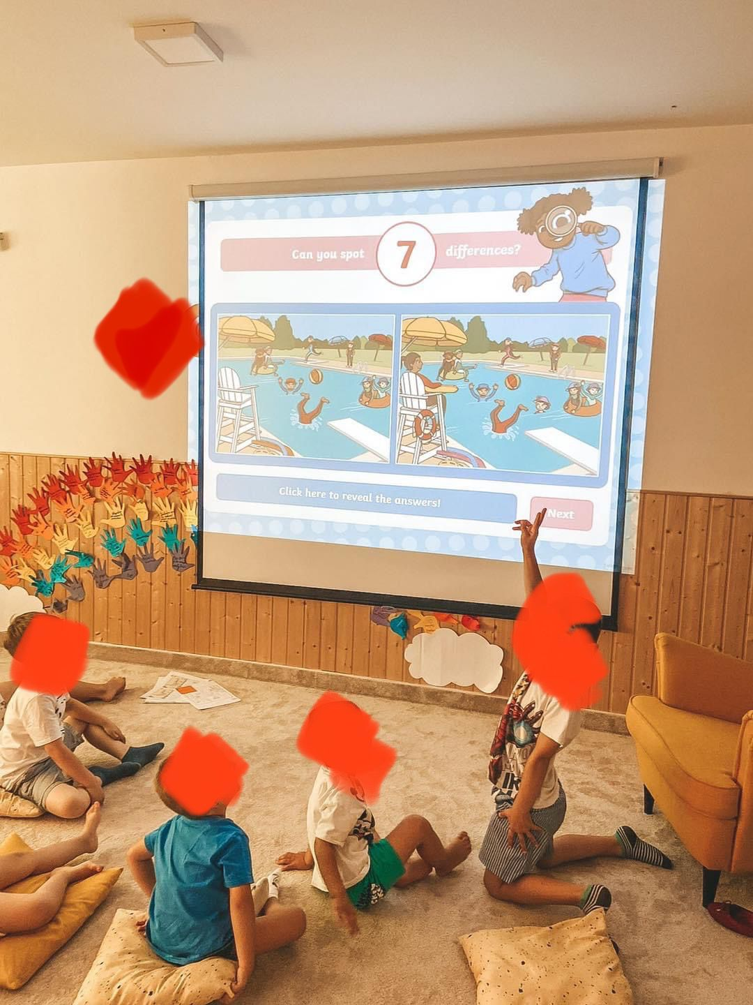

Slide 4
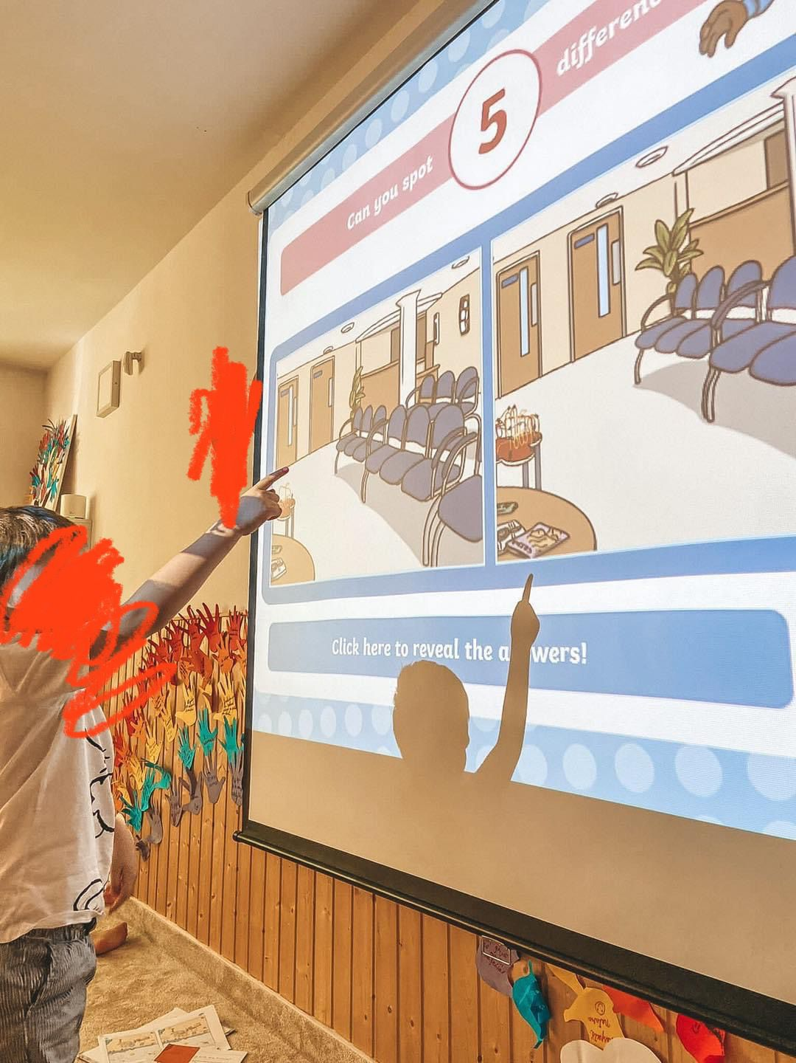
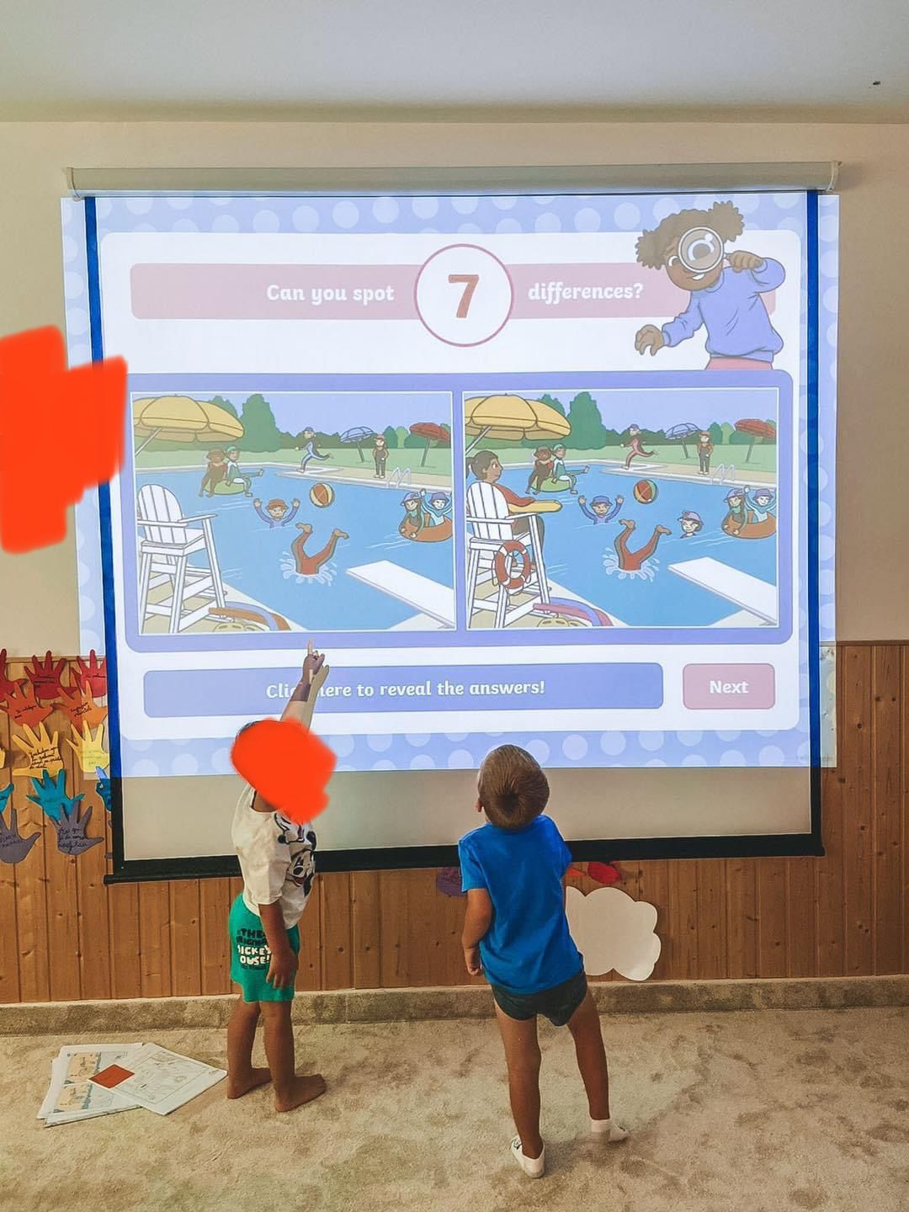

Slide 5
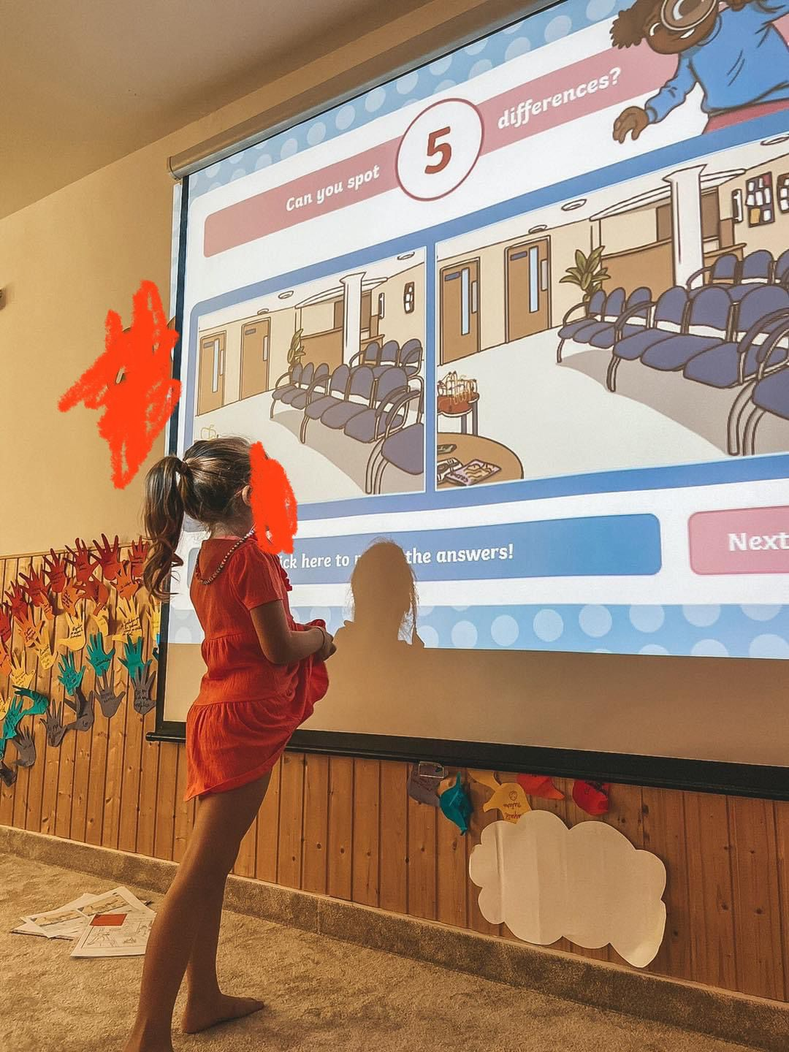
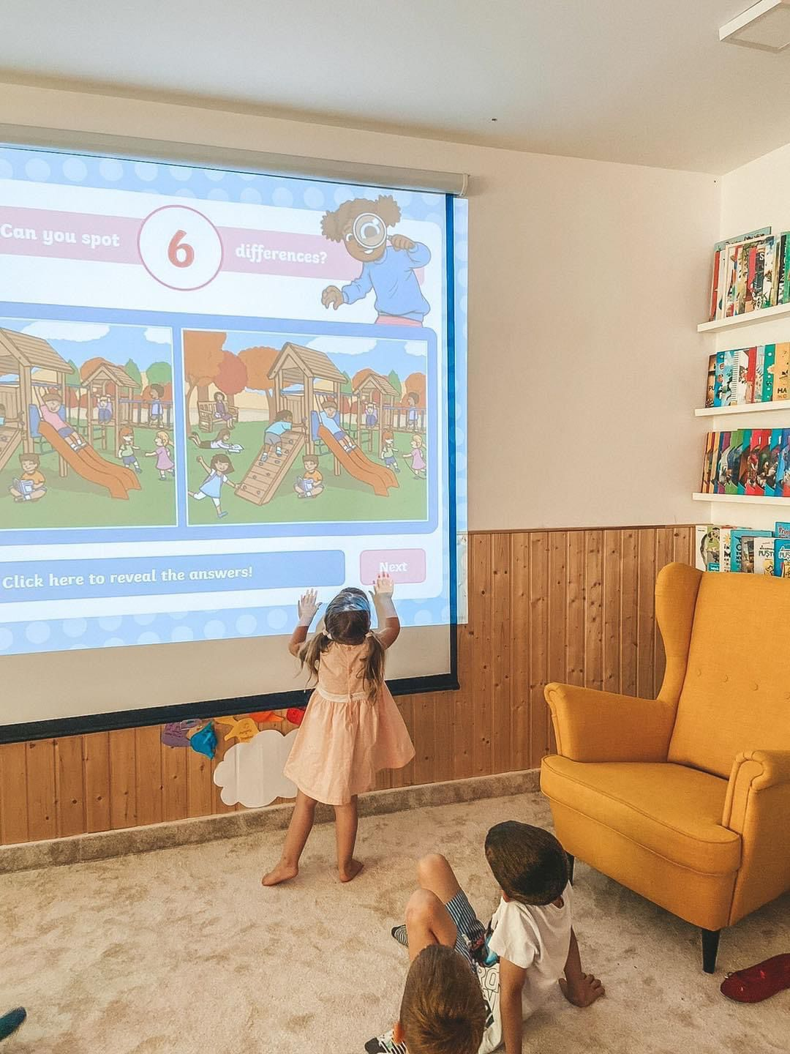

Slide 6
GRADE/AGE GROUP: 4-6 years old children
SUBJECT: English
AIM OF THE ACTIVITY: exploring the lingvistic functions by visual aids.
During this activity little children will learn the means of transportation and the specific vocabulary for this chapter.
This cognitive function will be stimulated by using different cartoons, different songs or interactive games.
Learning about transportation can be a fun activity and a great opportunity for creativity and imagination.

Slide 7
MATERIALS NEEDED FOR THE ACTIVITY:
board
cartoons
CD player
video projector
colored pencils
worksheets
DESCRIPTION OF THE ACTIVITY:
The activity takes place in 30 minutes. Children participate in 2 activities that stimulate their cognitive function and creativity. The curiosity of the little ones is captured through the prism of technology. The activity requires the little ones to identify words that are part of the vocabulary. Being on the topic of "Means of transportation" we proposed a game "I spy with my little eye". The little ones will identify means of transportation in the picture. In this way, through the game, their attention is captured. At the same time, this activity is a good opportunity to integrate CLIL. So, for each means of transportation found in the picture, they will learn the word in English, for example, "I spy with my little eye a ship".

Slide 8
Tips and Recommendations
https://www.youtube.com/watch?v=33y5vl7higE
https://ro.pinterest.com/pin/1759287344065270/
https://ro.pinterest.com/pin/558376053814806760/
https://www.youtube.com/watch?v=aHez0eBJEGw

