Slide 1
KINDERGARTEN WITH EXTENDED PROGRAM ,,MIHAI EMINESCU", TG-JIU
,,JOURNEY INTO THE WORLD OF STORIES"
FLOWERS" GROUP
PEOF. MERCUREAN IOANA OTILIA

Slide 2
IT IS A METHOD THAT ALLOWS THE CHILD TO DISCOVER 5 DISCIPLINES IN A SINGLE, INTERDISCIPLINARY APPROACH.
STEAM – IS AN EDUCATIONAL APPROACH TO LEARNING THAT USES SCIENCE, TECHNOLOGY, ENGINEERING, ART AND MATHEMATICS AS ACCESS POINTS TO GUIDE PRESCHOOL INQUIRY, DIALOGUE AND CRITICAL THINKING.

Slide 3
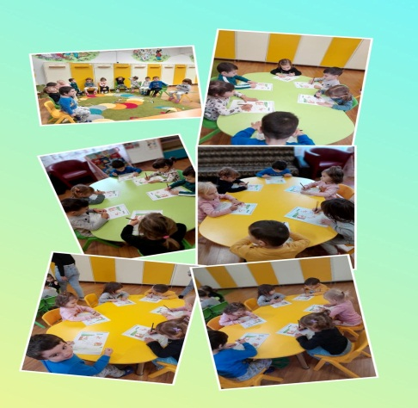
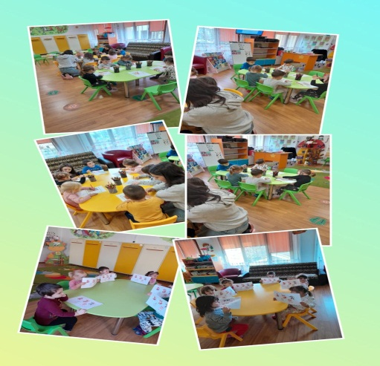
science
"THE ROAD TO GRANDMA'S HOUSE"
MAZE
THE PRESCHOOLERS HAD THE TASK OF HELPING RED RIDING HOOD TO FIND THE RIGHT WAY TO GRANDMA'S HOUSE.

Slide 4
technology
,,SPIN THE WHEEL!“
PRESCHOOLERS PRESENT SHOWED A MAJOR INTEREST IN THE GAME "SPIN THE WHEEL!" – WHAT STORY ARE THE IMAGES PART OF?” . TECHNOLOGY RELATES TO THE USE OF SIMPLE AND COMPLEX TOOLS – MICROSCOPES AND COMPUTERS.

Slide 5
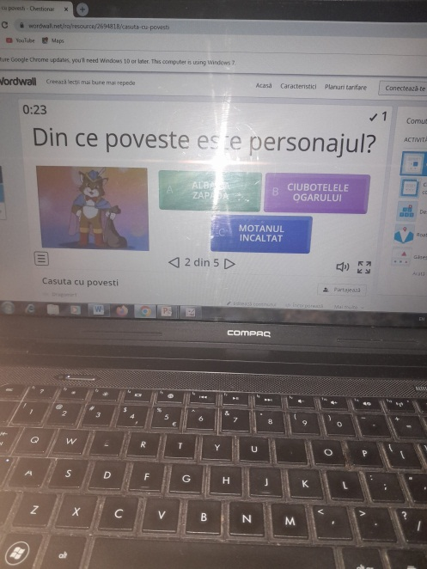
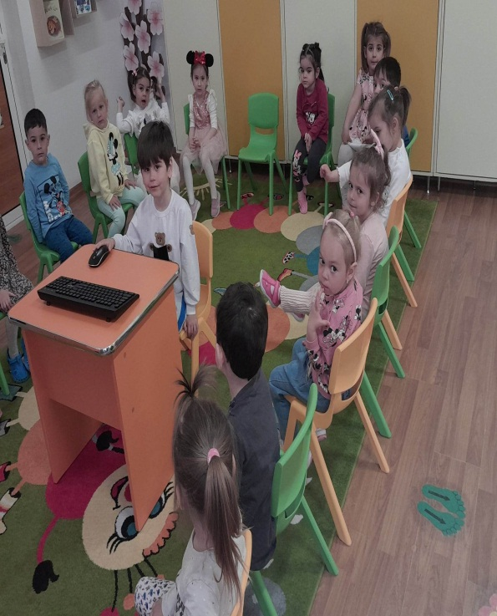
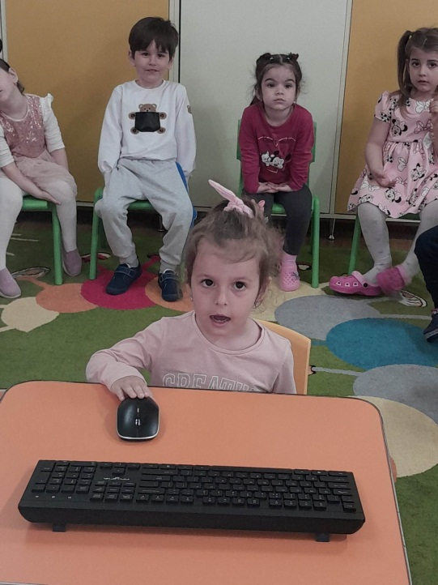
technology

Slide 6
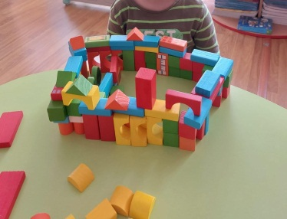
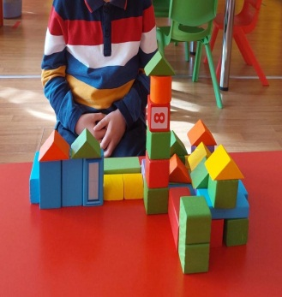
engineering
,,GRANDMA'S HOUSE"
THE SIMPLEST CONSTRUCTION GAMES ARE THOSE THAT CONTAIN WOODEN OR PLASTIC CUBES OF VARIOUS SIZES. WITH THEIR HELP, THE CHILD WILL LEARN TO DIFFERENTIATE BETWEEN SIZES, COLORS, NUMBERS AND HOW TO ORIENT THEMSELVES IN SPACE AND ARRANGE THE PIECES TO CREATE SOMETHING SPECTACULAR. SHOWING CREATIVITY, THE PRESCHOOLERS HAD TO BUILD "GRANDMA'S HOUSE".

Slide 7
the art
,,FAVORITE CHARACTER"
THE EXPRESSION "FINE ARTS" DEFINES ALL THE PRACTICES OR ACTIVITIES THAT ACHIEVE A REPRESENTATION THROUGH VISUAL IMAGES, WITH THE HELP OF POINTS, LINES, COLORS, SHAPES OR VOLUMES.

Slide 8
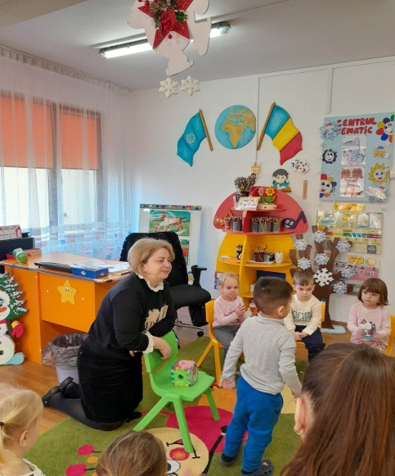
math
MATHEMATICAL ACTIVITY
..WHERE I PUT THE TOY" –
DIDACTIC GAME
PURPOSE OF THE ACTIVITY: CONSOLIDATING AND SYSTEMATIZING KNOWLEDGE REGARDING THE PERCEPTION OF THE SPATIAL POSITIONS OF SOME OBJECTS.

Slide 9
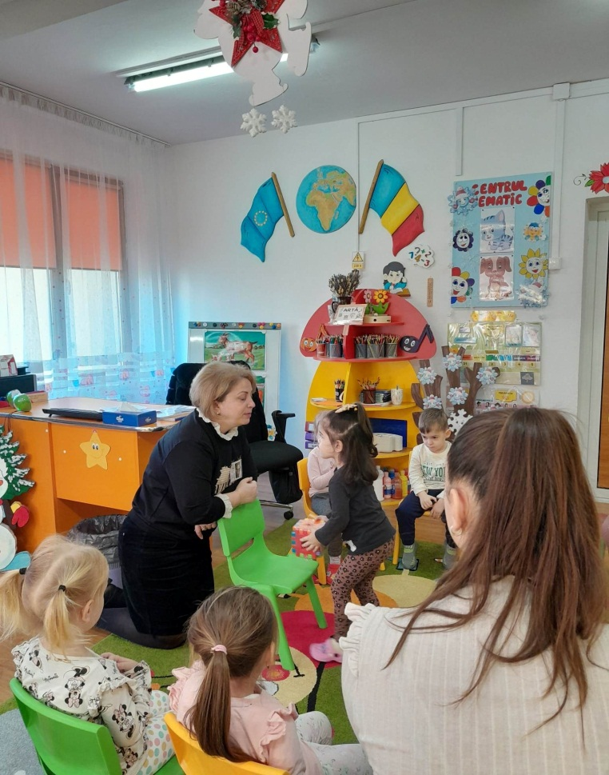
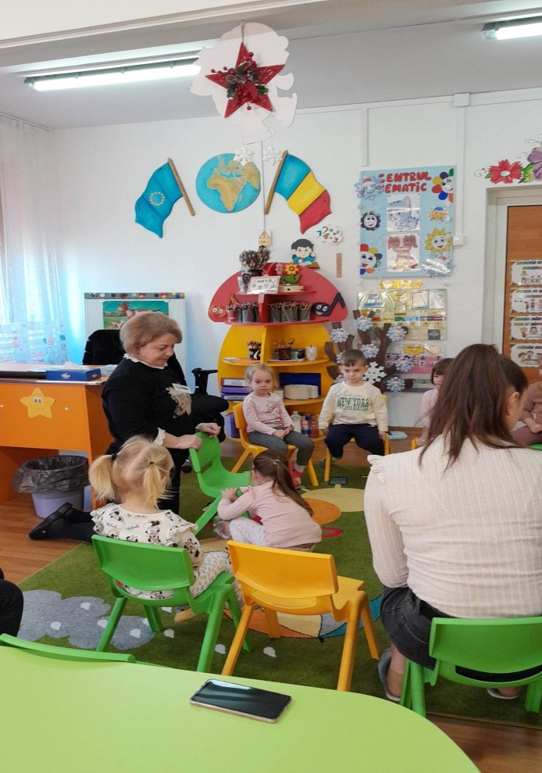

Slide 10
OBJECTIVES:
a). cognition
to name the toys;
of the toys;
to use appropriate mathematical language;
b). LOVE
to actively interfere in the activity;
to express feelings specific to the activity;
c). to adopt a correct position during the activity;

Slide 11
BIBLIOGRAPHY:
CURRICULUM FOR PRESCHOOL EDUCATION, BUCHAREST; 2
. LIFE LONG LEARNING PROGRAM, 2012-2013, OUTDOOR EDUCATION MANUAL;
3. METHODOLOGICAL LETTER FOR THE SCHOOL YEAR 2014-2015; 4. SUSILA, I, (1982), THE COLOR OF ALL DAYS, EDITURA ALBATROS, BUCHAREST;

