Slide 1
KINDERGARTEN WITH EXTENDED PROGRAM “MIHAI EMINESCU", TG-JIU, GORJ
In the wonderful world of autumn fruits
Teacher Maria-Augustina Jurebie

Slide 2
the steam approach in education
SCIENCE
INVESTIGATION
MATH
REFLECT
TECHONOLOGY
INVESTIGATING
ENGINEERING
ADJOINS
THE ARTH
CREATE

Slide 3
Name of the activity: IN THE WONDERFUL WORLD OF AUTUMN FRUITS
Photo/Video of the activity:
Grade/Age (of the kids): 5-6 years
Subject (The Art, Maths, Technology, Science): STEAM
Aim of the activity (Explain what skills, information, experience, etc. should be gained, practiced, …):
Developing the ability to know and understand the environment, as well as stimulating curiosity to investigate it - strengthening knowledge about fruits ;
Developing the ability to apply in practice the information and theoretical knowledge acquired;
Promoting the improvement of skills in constructive activities - creatively combine construction pieces to complete the theme (crates for fruits );
Educating children's creativity and independence in action - strengthening the skills and abilities to paint and draw (as a means of plastic expression) in order to create individual works (fruits);
Developing the ability to understand and use numbers, figures, using an appropriate vocabulary - relating number to quantity and quantity to number;
Development of cooperative, prosocial, proactive (initiative) behaviors;
The development of oral expression, understanding and correct use of the meanings of oral verbal structures, in English.

Slide 4
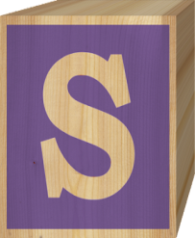
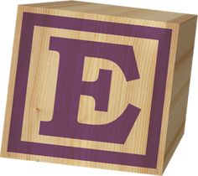
Materials needed for the activity:
interactive whiteboard/laptop
magnetic board
boards with the living environment
tokens with fruits
tokens with numbers, egg molds, materials from nature, seeds of various kinds, cones, chestnuts, rose hips, nuts, leaves.
magnetic numbers
markers
digital games
www. wordwall.net
www.jigsawplanet.com
Colors, watercolors
wooden cubes
LEGO cubes
Length of the activity (Indicate in minutes): 30 minutes
Number of participants: 25 preschoolers .

Slide 5
science
Display of fruit books, charts and encyclopedias, exploring in mod independently of them by the children, in the stages of freely chosen activities and games.
Q&A sessions: about the market, about health.
Comparing the texture/taste/shape of fruits.
The transformation of sugar by dissolution in the practical activity – compote, sharing findings; fruit oxidation.
Making predictions/hypotheses and checking them.

Slide 6
technology
Using the laptop to view presentations with information and images themed.
Using the phone to photograph fruits and make an album of them autumn fruits.
Using the blender to make applesauce.
Using the scale in the role-playing game "At the market“.
Use of the timer in sports competitions.
Using kitchen tools to make a fruit salad.

Slide 7
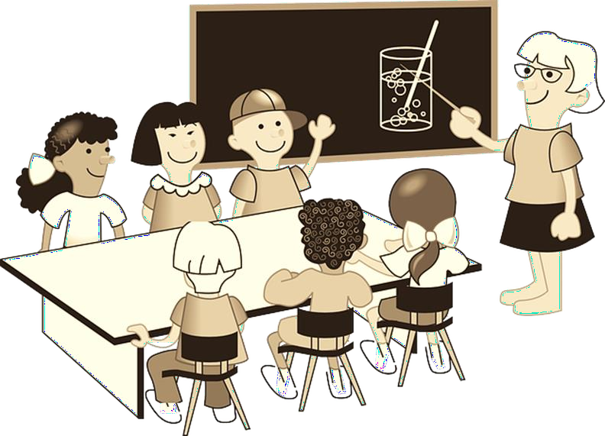
engineering
Building a market at the Role Playing Center for the implementation of the game "At the market"/ "From the seller".
The construction of shelves for the warehouse (jars of compote); exploring the concept of balance.

Slide 8
the art
Fruit modeling.
Creating an autumn painting by means of the fingerprinting method. (The Apple)
Making a collage. (Fruit Basket)
Music audition. (The Seasons, by Vivaldi)
The group's album. (Fruit face)

Slide 9
math
To recognize numbers
To form sets of objects
To relate number to quantity and vice versa
To count ascending and descending

Slide 10
During the preschool activity, the following succeeded:
To observe and discover the surrounding nature
To work in a team (teams of two in the Domino game)
To experience emotions of joy, admiration, delight
To learn through play
Be careful
To ask questions
To recognize numbers
To form sets of objects
To relate number to quantity and vice versa
To count ascending and descending

Slide 11
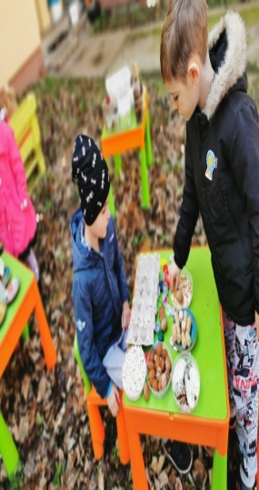
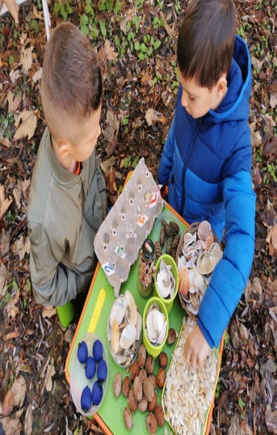
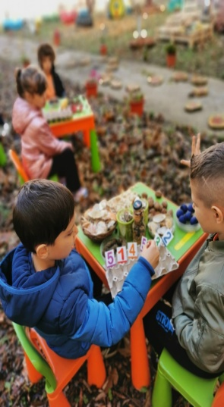
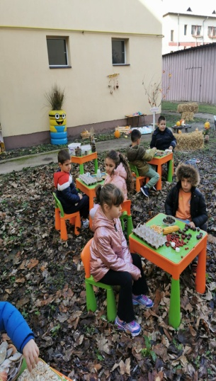
Photos:

