Slide 1
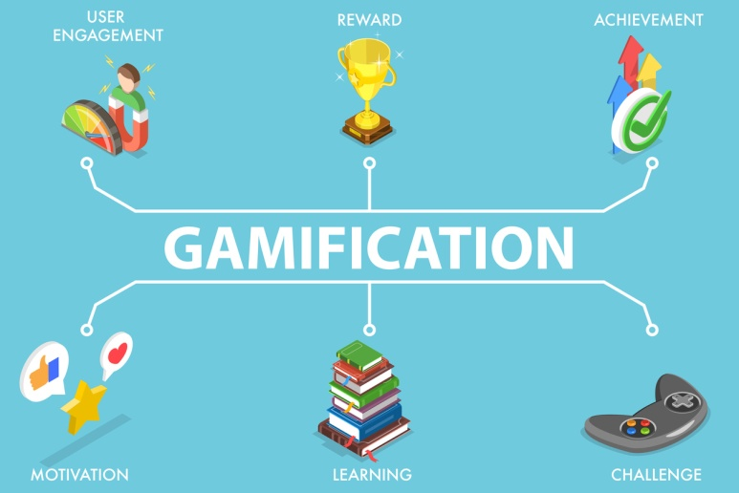
KINDERGARTEN WITH EXTENDED PROGRAM ,,MIHAI EMINESCU”, TG-JIU
,,SPRING VITAMINS”
GROUP ,,ŞTRUMFII”
PROF. FUGACIU MIHAELA

Slide 2
STEAM- is the English acronym for Science, Technology, Engineering, Art and Mathematics.
It is a method that allows the child to discover 5 disciplines in a single, interdisciplinary approach.

Slide 3
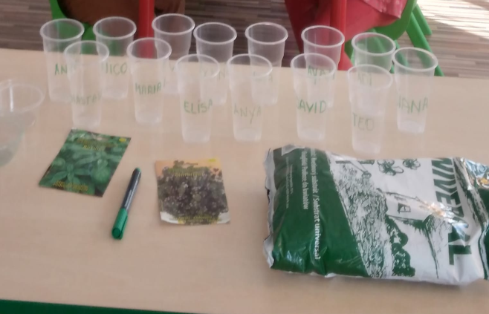
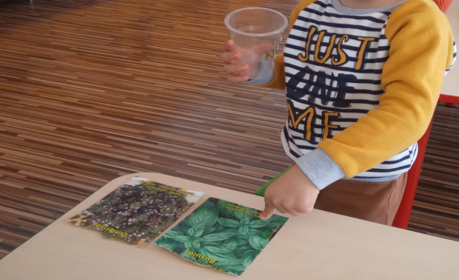
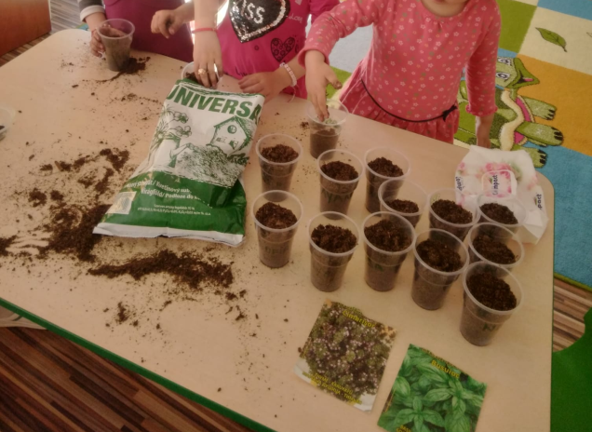
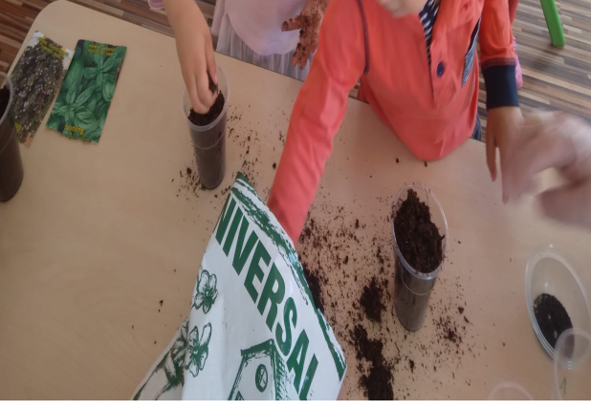
Science
,,The glass garden”– experiment
By carrying out an experiment, the preschooler acquires some practical skills, develops his logical thinking and creativity.​

Slide 4
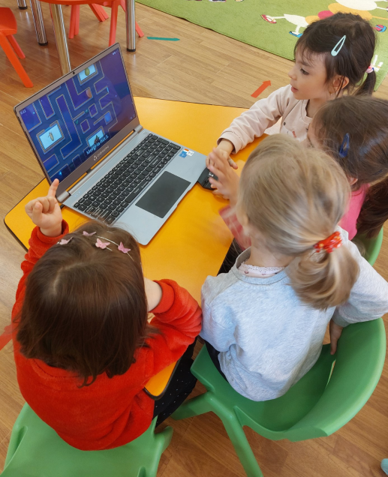
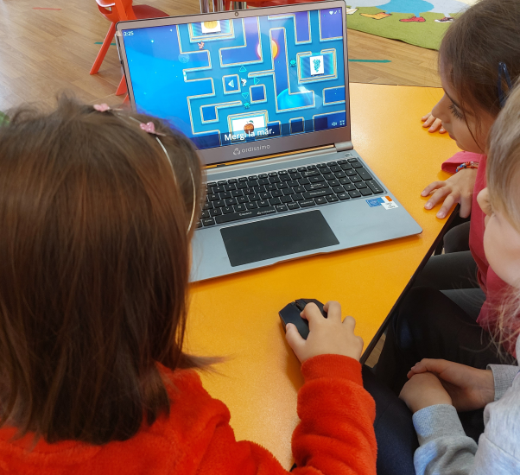
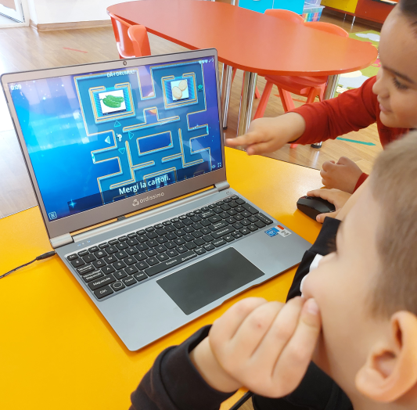
Technology
,,GRANDMOTHER'S PANTRY”
Preschoolers made contact with technology by exploring it with the help of maze games. Solving the maze is an activity that helps them to have more confidence in themselves, to be successful immediately and move on to more difficult games or more complicated mazes that test attention. These games encourage spatial thinking.​

Slide 5
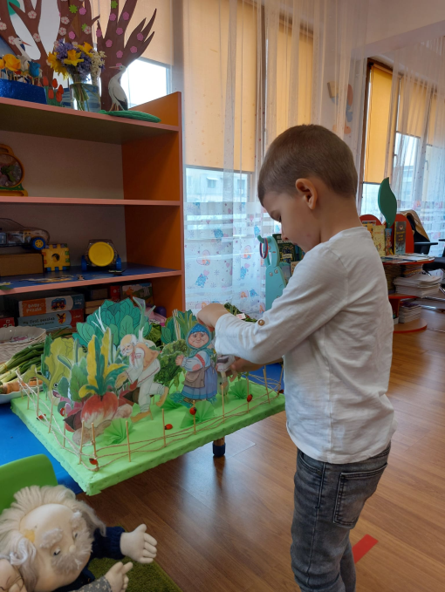
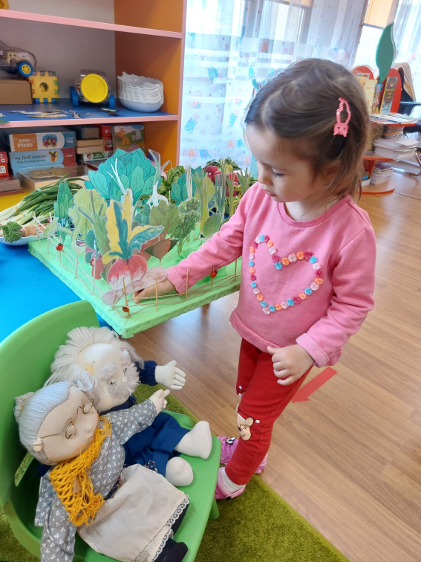
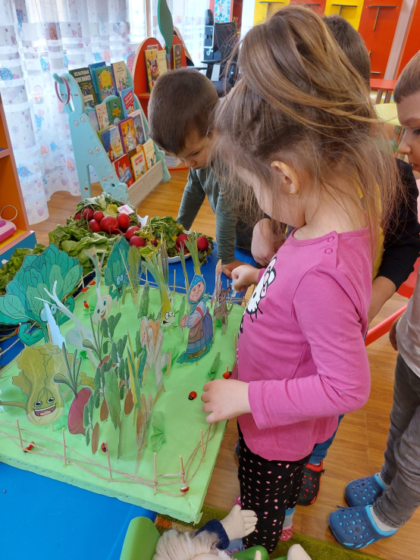
Engineering
,,Fence for my garden”
Preschoolers explored engineering concepts in construction when they put new ideas into practice and built a fence​.

Slide 6
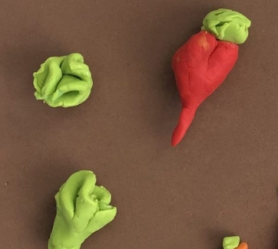
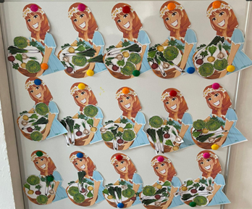
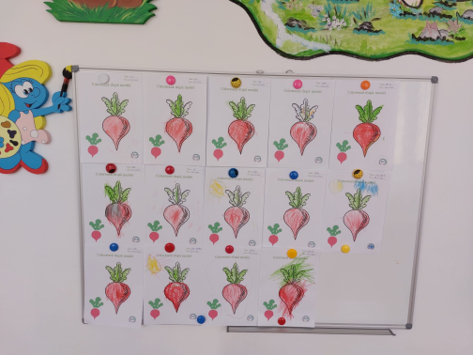
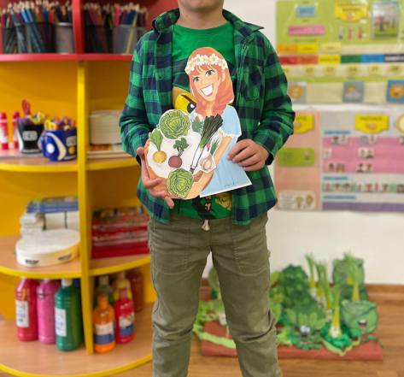
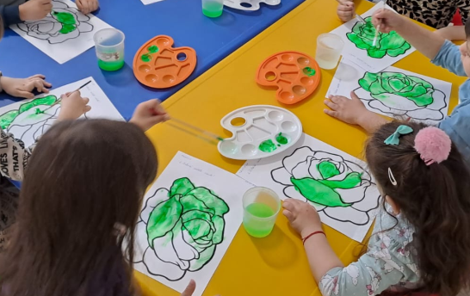
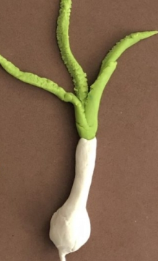
Art
,,VEGETABLE GARDEN”
Art means creativity, it involves open-ending activities. In addition to the joy, emotions and satisfaction of children, "Art" offers the little ones the framework in which they learn to communicate, stimulating their curiosity, imagination, creativity, but also the spirit of initiative.​

Slide 7
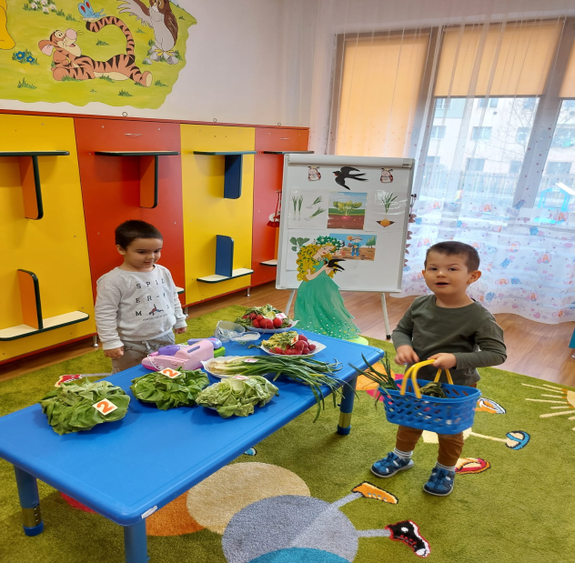
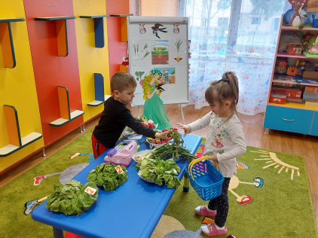
Mathematics
Mathematical activity "Please give it to me!" - didactic game
PURPOSE OF THE ACTIVITY: Consolidation of children's knowledge of numbers within the limits of 1-5; the development of attention and thinking operations.​​

Slide 8
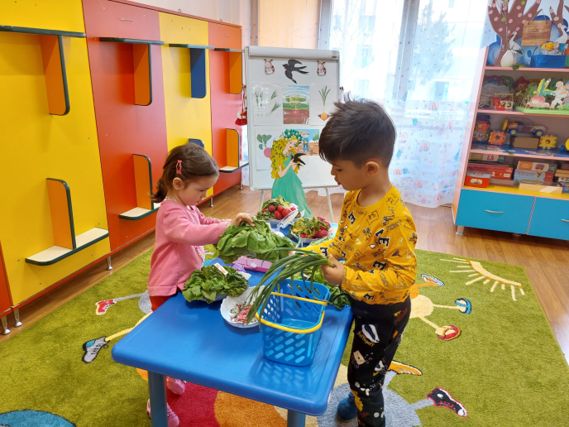
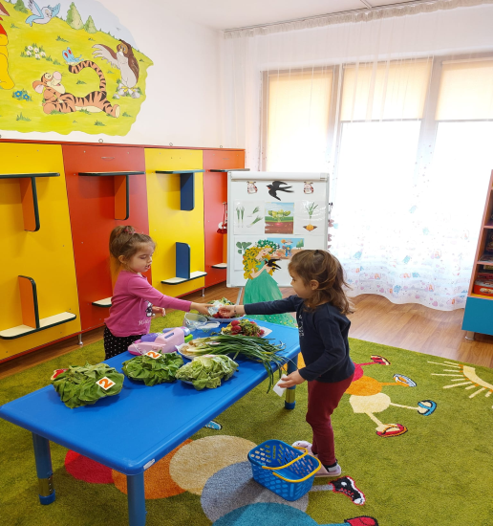
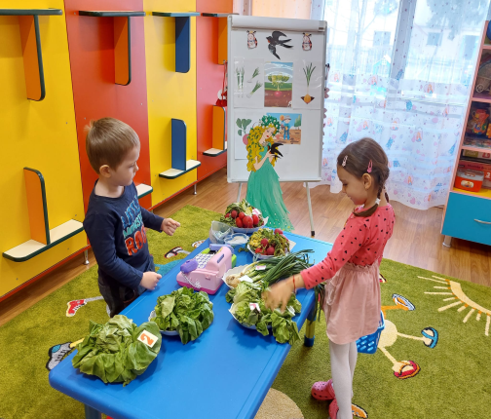
OBJECTIVES:
Cognitive:
To count in ascending and descending order within the limits of 1-5;
To recognize the numbers 1,2,3,4,5;
To relate the number to the quantity and the quantity to the number;
To solve the maze correctly;
To use an appropriate mathematical language.
Affective:
to be actively involved in the activity;
to express own affective feelings specific to the activity;
to be able to establish intercommunication and cooperation relations with group members.
Psychomotor:
to have a correct position throughout the activity;
to handle the didactic material with care.

Slide 9
BIBLIOGRAPHY:
1.Curriculum ptr Invatamantul prescolar,Bucuresti;
2.Life Long Learning Program,2012-2013,Manual de eductie outdoor;
3.Scrisoare metodică pentru anul școlar 2014-2015; 4.Susila,I,(1982),Culoarea cea de toate zilele,Editura Albatros,Bucuresti;

