Slide 1
EXTENDED PROGRAM KINDERGARTEN "MIHAI EMINESCU" TG-JIU
"LET'S HELP FIFI THE BEE!"
STEAM ACTIVITY BASED ON GAMEPLAY AND GAMIFICATION
Grade/Age (of the kids): 4-5 years
Subject (Maths, English, Science): STEAM, English
Length of the activity (Indicate in minutes): 20-25 minutes
Number of participants: 20 preschoolers .
TEACHER ,
DAMIAN CORINA

Slide 2
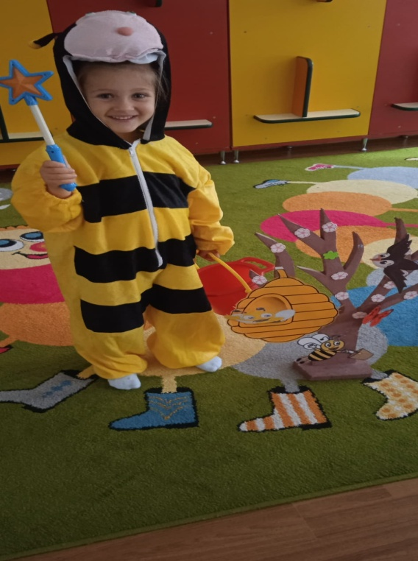
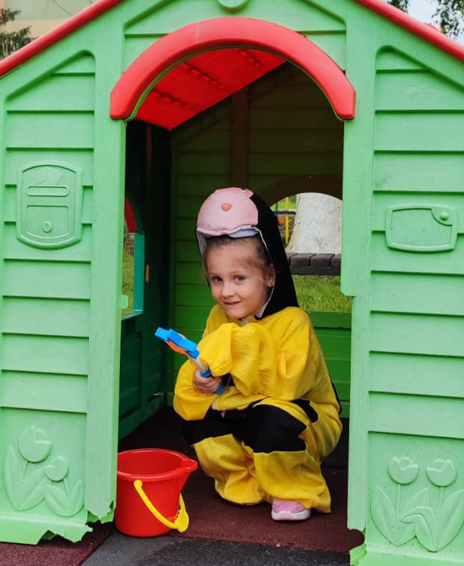
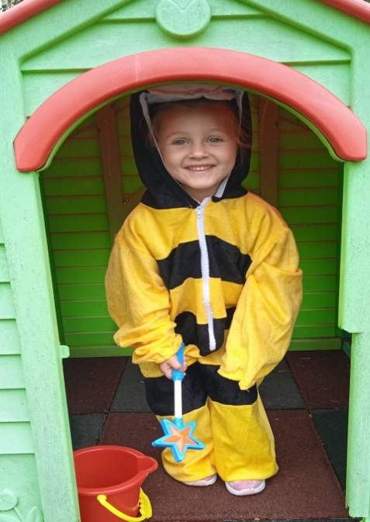
CATCHING THE ATTENTION
It was done with the help of the bee Fifi who is locked in the house by the wicked witch.
She recited the lines:
"Hello, dear children!/ I'm Fifi the bee.
And I'm very scared/ Because a wicked witch
Craving my honey /She wants to keep me locked up/ In her house.''
The children's correct answers saved the bee.

Slide 3
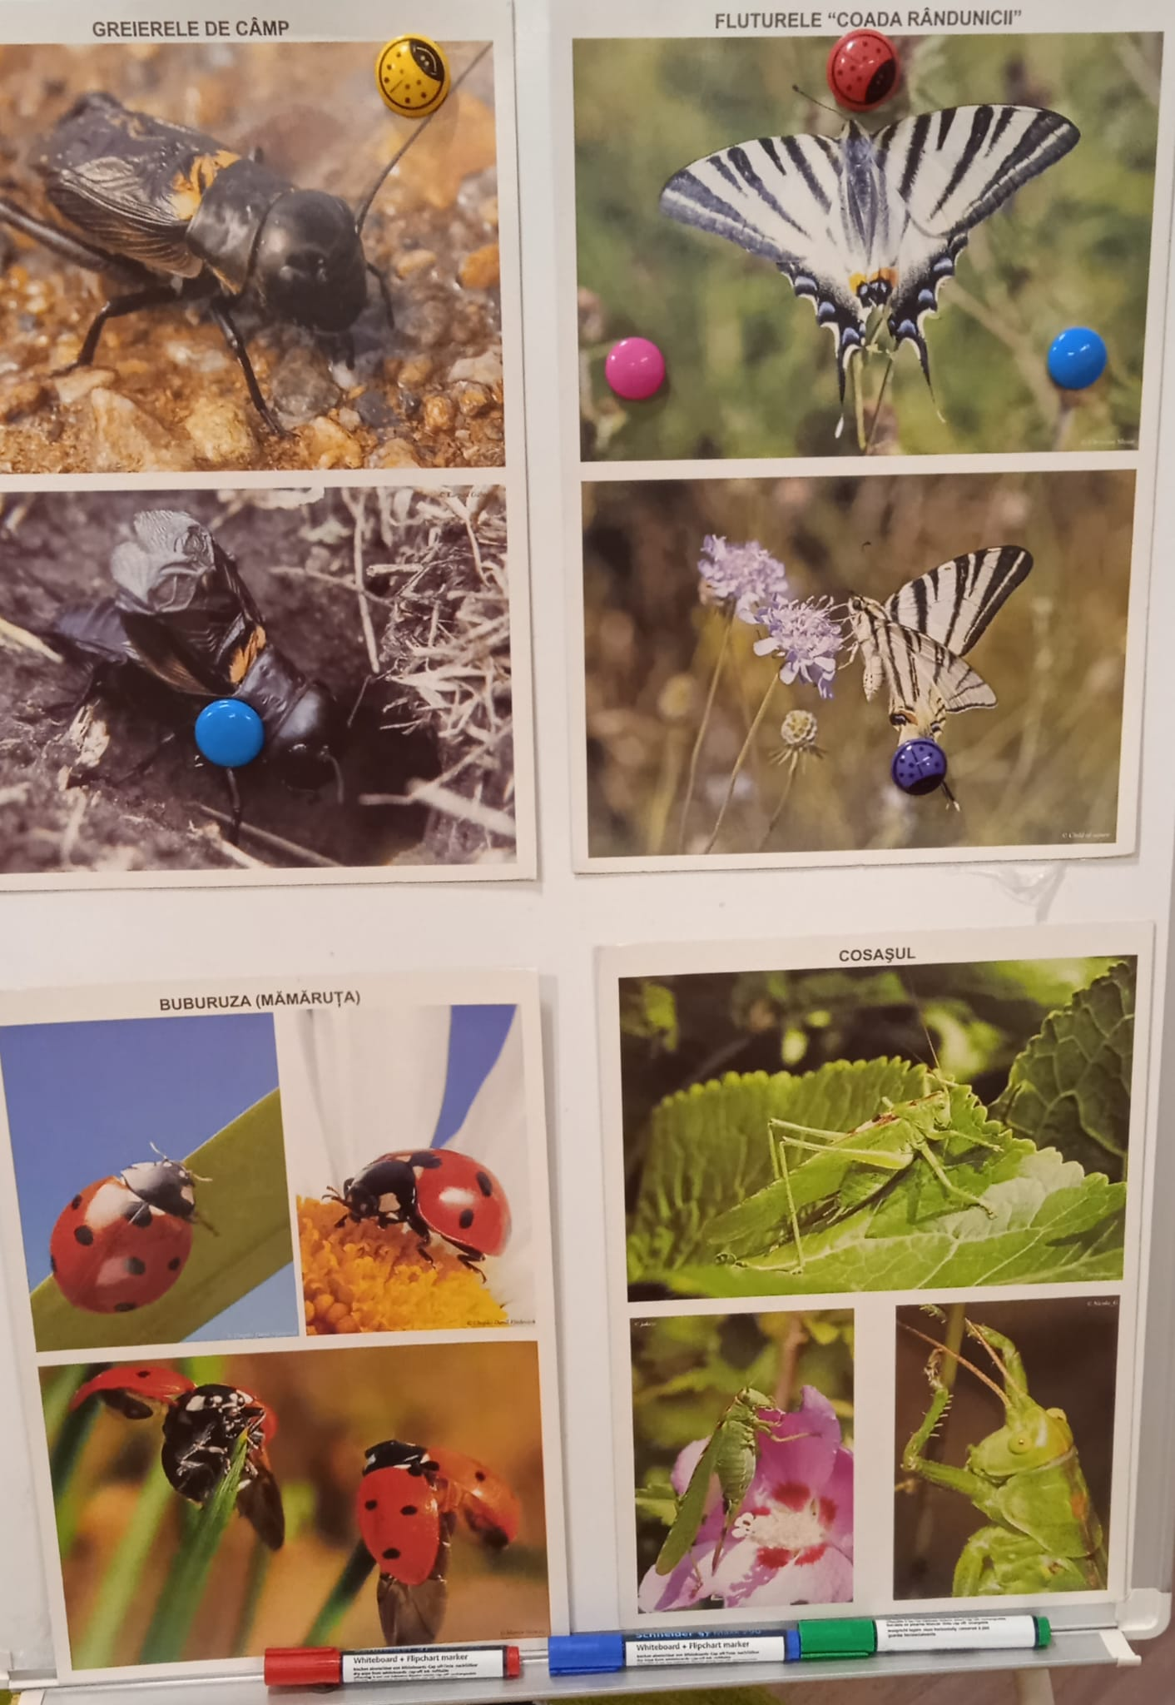
UPDATE OF KNOWLEDGE
It was made using images of insects. The children correctly pronounced, in English, the names of known insects.

Slide 4
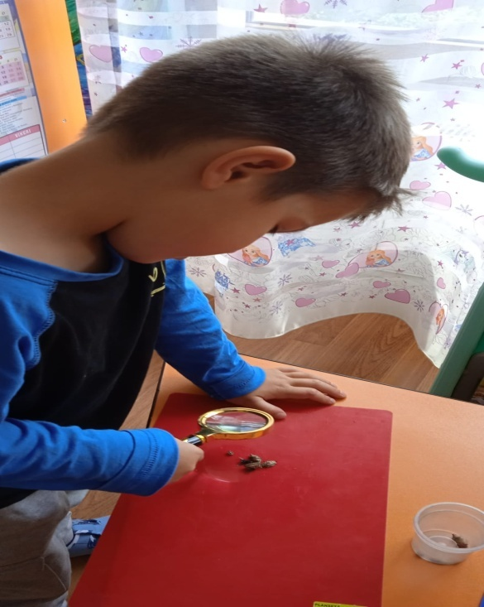
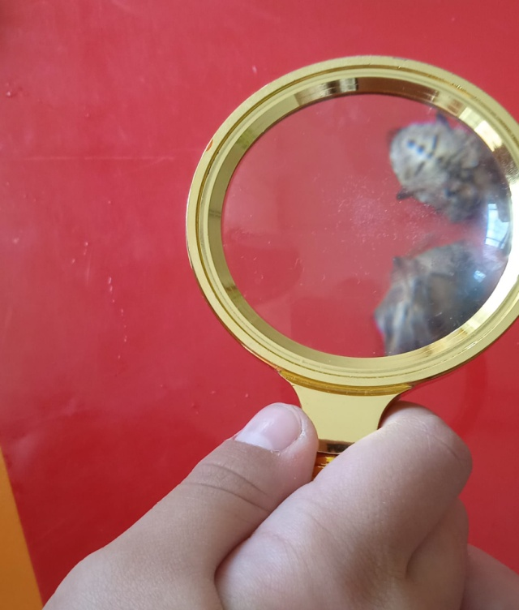
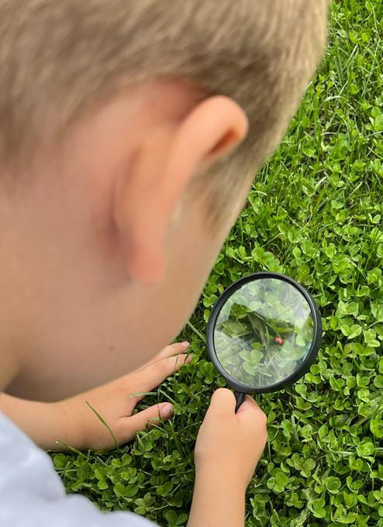
DIRECTING LEARNING
Children are curious by nature, and STEAM activities build on this innate curiosity.
Next, the named child chose a magnifying glass with which he examined an insect, listing the component parts of its body and presenting the benefits or harms.

Slide 5
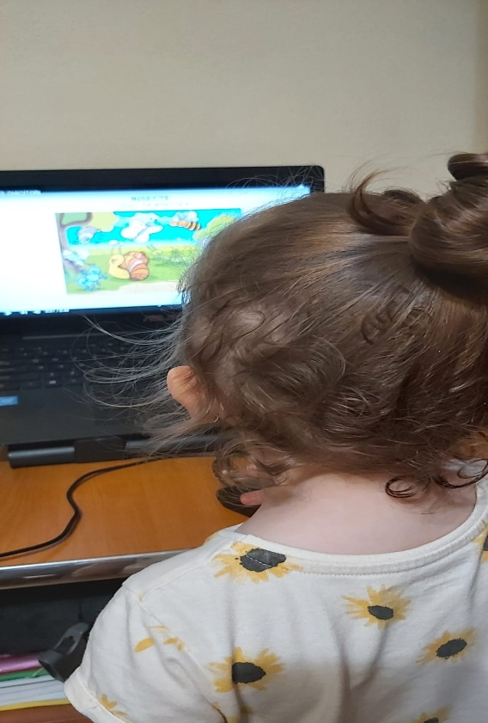
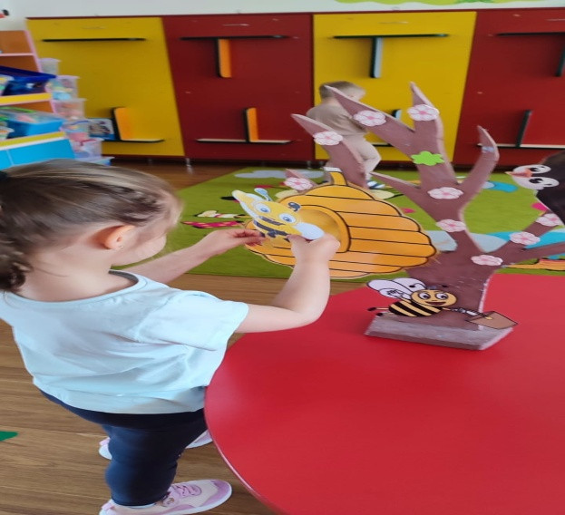
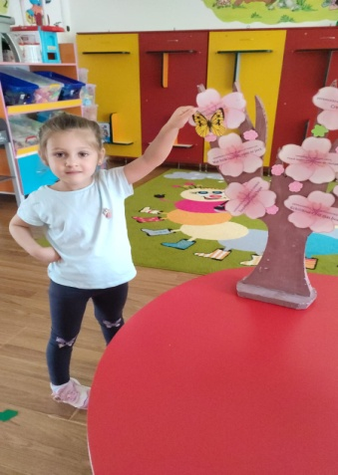
The children responded to the riddle from the educational software: "Guess what insect it is!“. They named the insects in English and placed them in their living environment. (hive, flower, mushroom).

Slide 6
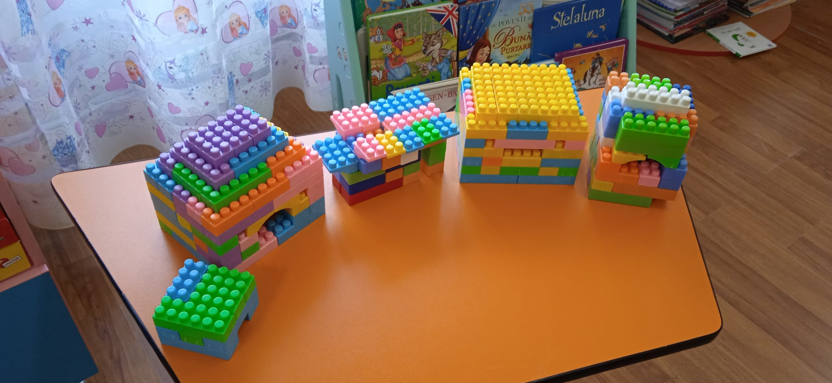
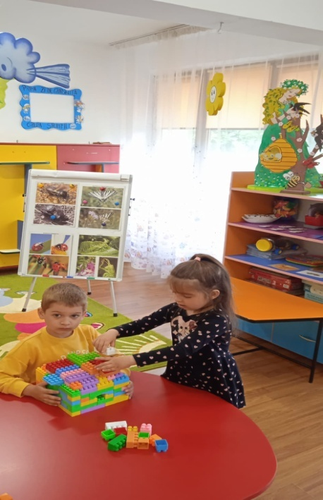
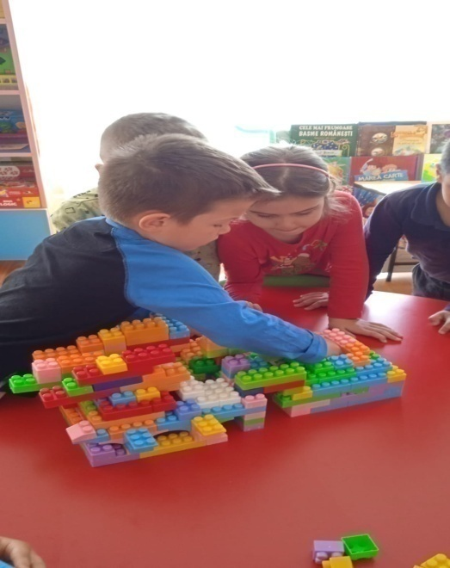
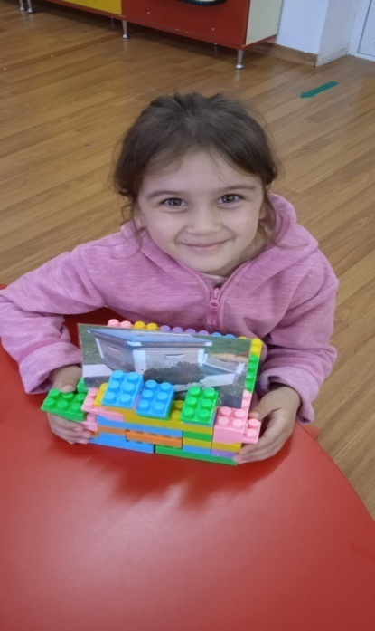
Children explored engineering concepts in construction, building beehives out of LEGO bricks.

Slide 7
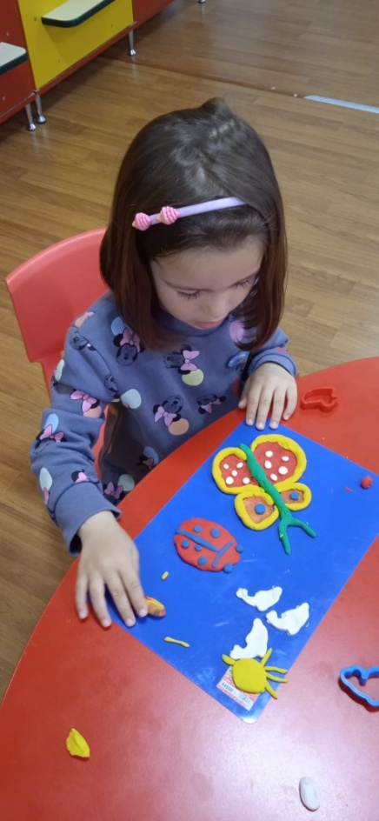
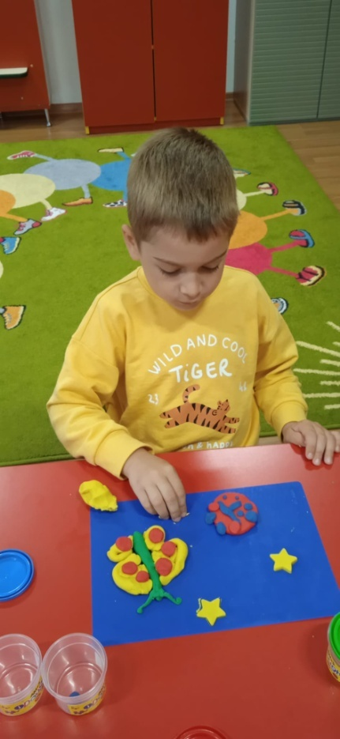
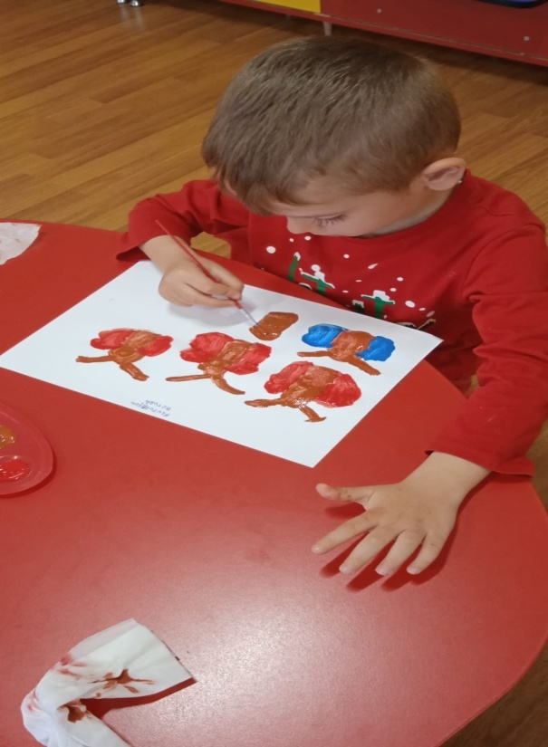
Art means creativity, and the children modeled, through the translational and circular movement of their palms against the board, their favorite insect and painted multicolored butterflies.

Slide 8
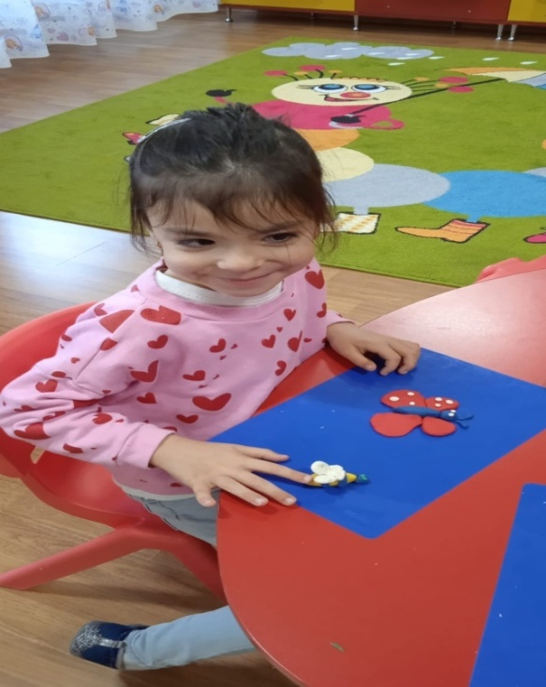
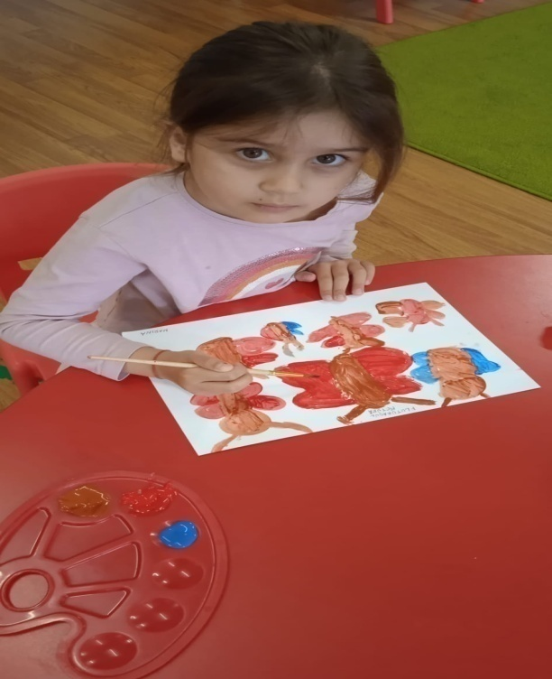
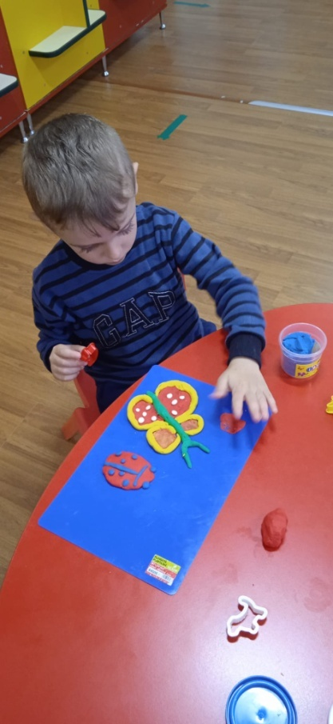
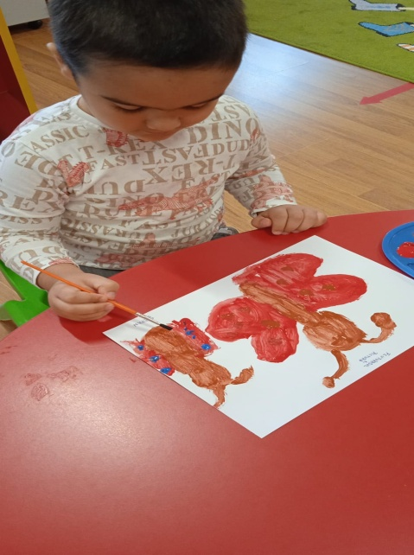

Slide 9
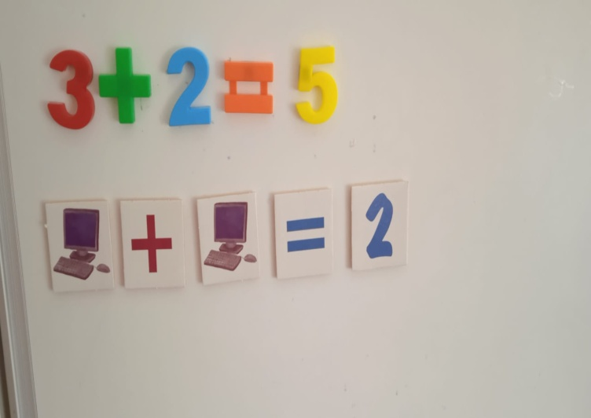
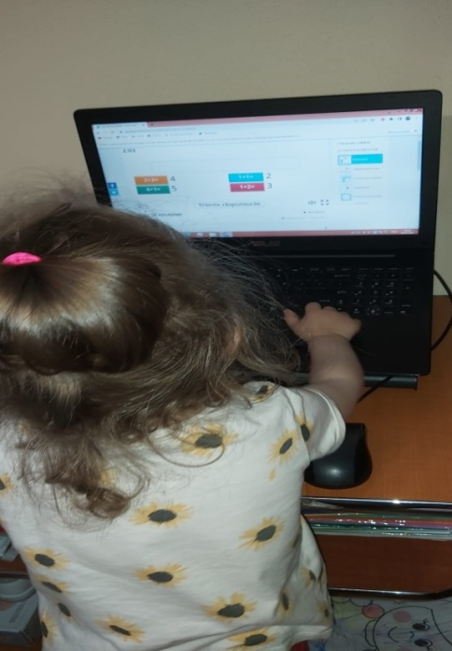
OBTAINING PERFORMANCE AND ENSURING TRANSFER
The achievement of performance was accomplished through the game-exercise: "Let's Add Up!" in which children solved addition exercises within the range of 1-5 with one or two units.
PROVIDING FEEDBACK AND PERFORMANCE EVALUATION
It was accomplished through digital games and created on the platform: www.worwall.net.

Slide 10
ENDING THE ACTIVITY
At the end of the activity, individual and collective assessments were made and rewards were offered.
THANK YOU!

