Slide 1
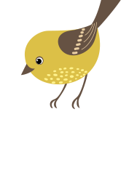
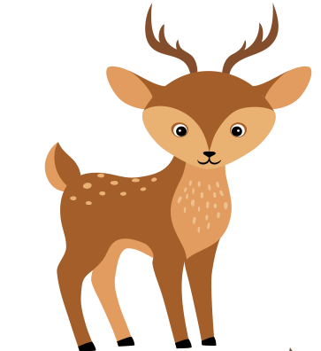
GAME-BASED LESSONS IN KINDERGARTEN
JOURNEY... IN THE WORLD OF ANIMALS
Subject: English

Slide 2
AIM OF THE ACTIVITY
Developing the ability to know and understand the environment, as well as stimulating curiosity to investigate it - consolidation of knowledge about domestic and wild animals (from the forest and jungle: name, habitat;
Promoting the improvement of skills in constructive activities - creatively combine the construction pieces to complete the theme (animal shelter);
Educating children's creativity and independence in action - consolidation of skills and modeling skills (as a means of plastic expression) in order to create individual works (animals), using the translational and circular movement of the palms in relation to the board, by pressing-flattening with the help of the palm on the board;
Developing the ability to understand and use numbers, figures, using an appropriate vocabulary - relating number to quantity and quantity to number;
Development of cooperative, prosocial, proactive (initiative) behaviors;
Developing the capacity for oral expression, understanding and correct use of the meanings of oral verbal structures, in English

Slide 3
Materials needed for the activity
digital games
www. wordwall.net
www.jigsawplanet.com
plasticine
wooden cubes
LEGO cubes
interactive whiteboard/laptop
magnetic board
boards with the living environment
tokens with domestic animals
wild animal tokens
magnetic numbers
markers
powerpoint presentation "Farm Animals"
powerpoint presentation "Wild animals in the forest"
powerpoint presentation "Wild animals in the jungle"

Slide 4
LENGTH OF THE ACTIVITY
(INDICATE IN MINUTES)
30-40 minutes
Number of participants
20 preschoolers
2 teams of 10 kids

Slide 5
DESCRIPTION OF THE ACTIVITY

Slide 6
1. ATTENTION CAPTURE

Slide 7
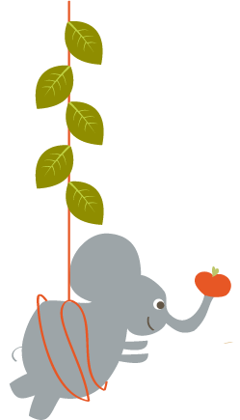
Capturing attention and interest in the activity will be achieved with the help of a surprise character who does not remember who he is and where he lives.
https://www.duckduckmoose.com/educational-iphone-itouch-apps-for-kids/chatterpix/

Slide 9
2. UPDATE OF KNOWLEDGE

Slide 10
Updating previous knowledge is done with the help of powerpoint presentations:
"Farm Animals”
"Wild animals in the forest”
"Wild animals in the jungle"
Children will correctly pronounce, in English, the names of domestic and wild animals

Slide 12
3. LEARNING DIRECTION

Slide 13
The child named chosen by the surprise character will choose a token, to the question "What is this?", he will name, in English, the animal represented in the image on the token and to the question "Where does he live?" will place on the magnetic board on the boards that represent the living environment in which the respective animal lives: farm, forest, jungle)

Slide 17
Kids will explore engineering concepts in construction by building animal shelters out of wooden blocks and LEGO blocks.
Art means creativity, and children will model, through the translational and circular movement of their palms against the board, their favorite animal

Slide 20
4. ACHIEVING PERFORMANCE

Slide 21
Achieving the performance will be achieved through the exercise game
"Place in the crowd as many animals domestic or wild as the number shows you (1, 2, 3, 4, 5!"

Slide 24
5. ENSURING THE REVERSE CONNECTION (FEEDBACK)
AND PERFORMANCE EVALUATION

Slide 25
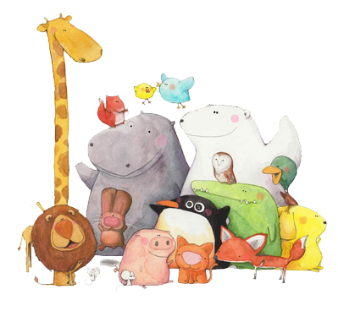
Ensuring the reverse connection (feedback) and performance evaluation will be done through digital games created on the platforms:
1
https://wordwall.net/ro/resource/56466466/wild-jungle-animals
2
https://www.jigsawplanet.com/?rc=play&pid=2cec516cfc41
3
https://www.jigsawplanet.com/?rc=play&pid=2b25bb81d494
4
https://www.jigsawplanet.com/?rc=play&pid=1bc782d7a796
5
https://www.jigsawplanet.com/?rc=play&pid=3f92526c46fb

Slide 30
TEACHER: ANA-MARIA BIZDOACA
KINDERGARTEN ,,MIHAI EMINESCU”
TARGU-JIU, ROMANIA

